Slide 1
Seaside at Scituate Age Restricted Townhome Community for Active Adults 55+

Slide 2
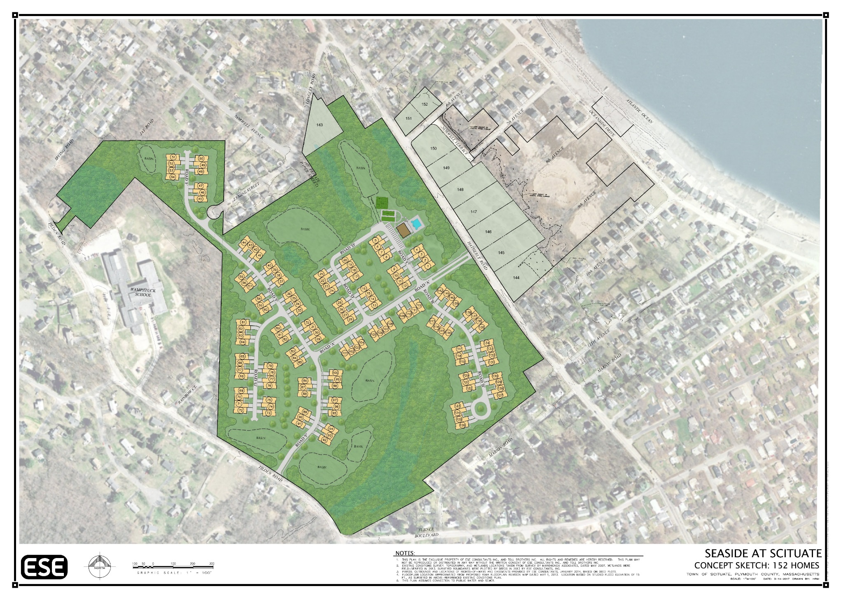
PROPOSED COMMUNITY

Slide 3
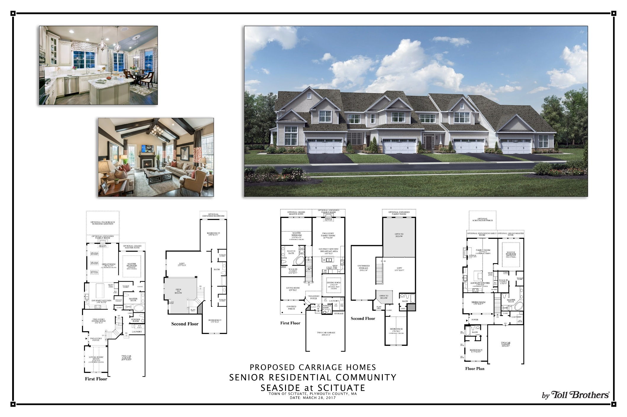

Slide 4
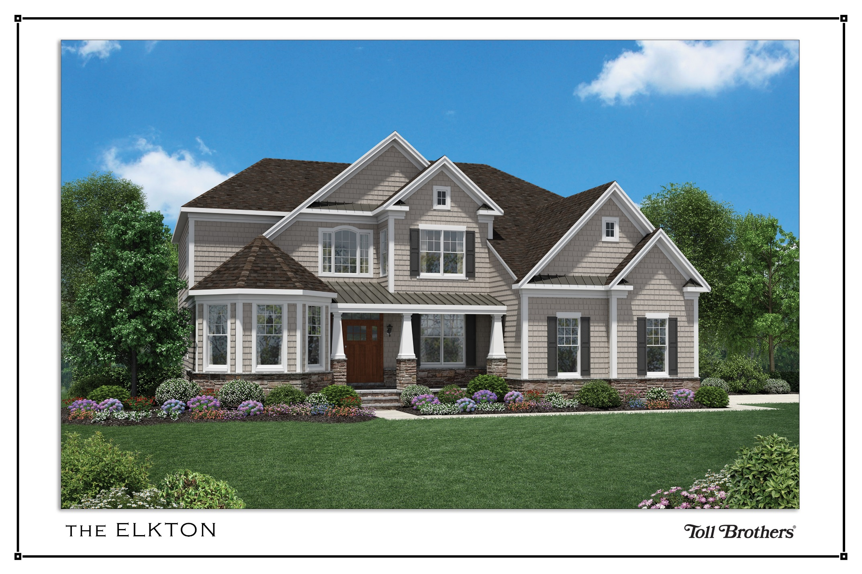

Slide 6
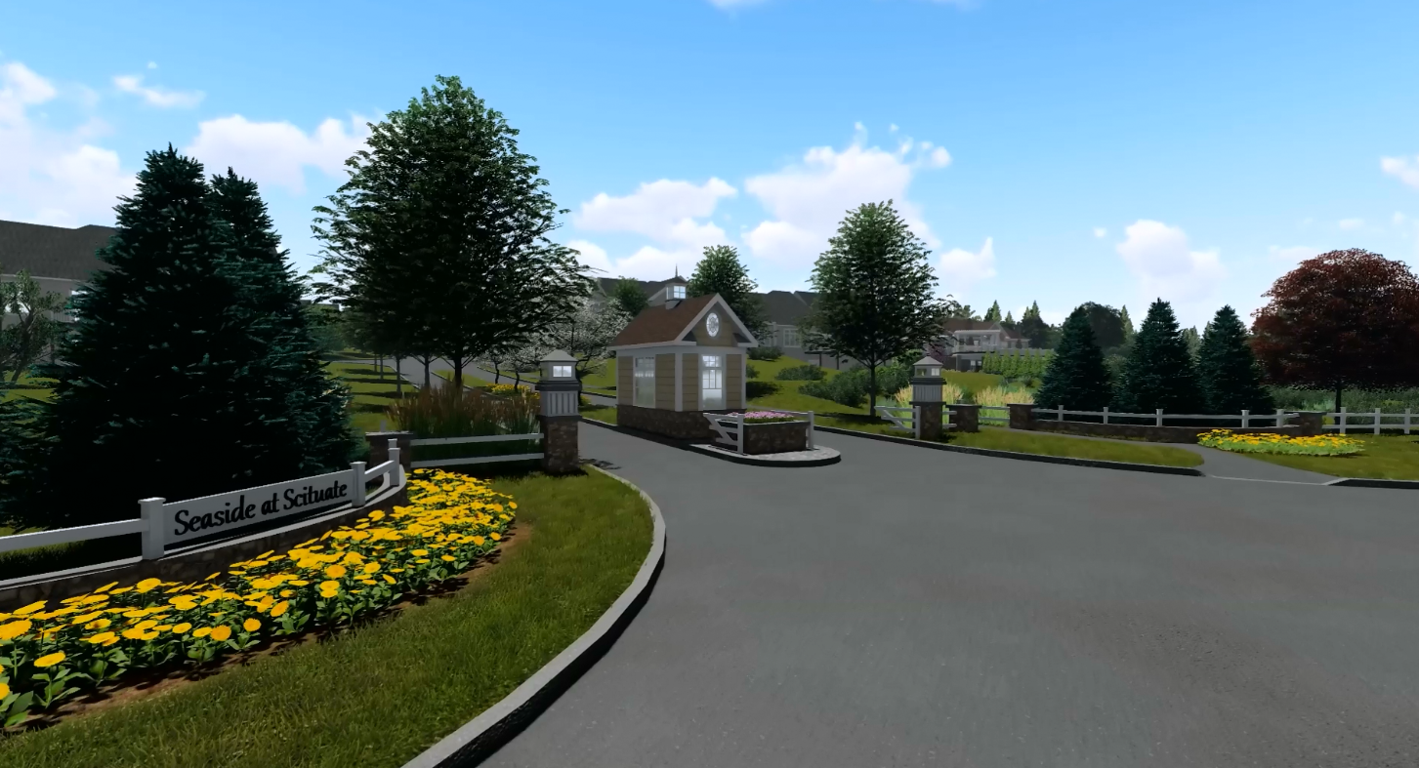

Slide 7
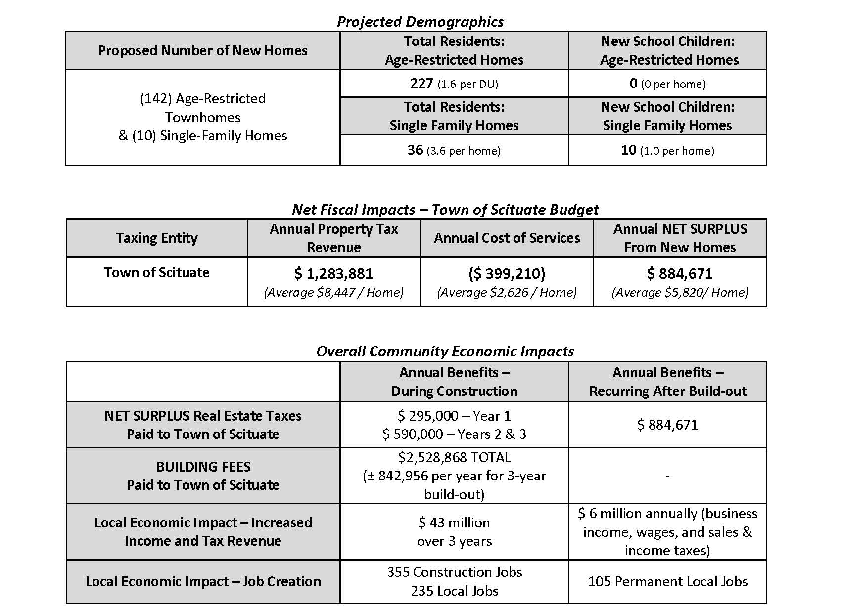
FISCAL IMPACTS

Slide 8
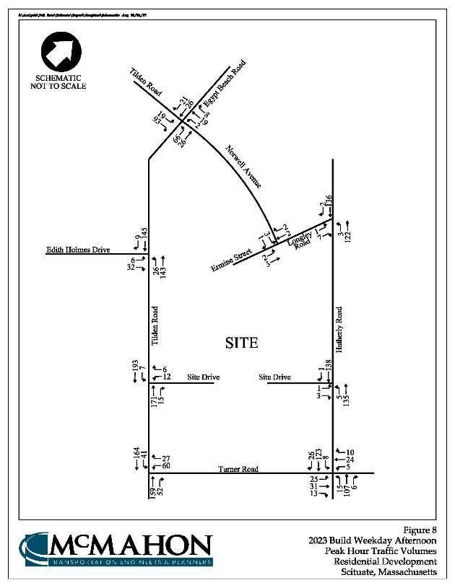
TRAFFIC IMPACTS
Traffic Impact Study Completed in March 2017
Study Area Included:
Hatherly Road at Longley Road
Hatherly Road at Community Entry
Hatherly Road at turner Road
Tilden Road at Community Entry
Tilden Road at Edith Holmes Dr.
Tilden Road at Norwell Avenue
Norwell Avenue at Ermine Street/Longley Road
Peak Hour Trip Generation
AM – 58 new vehicle trips
PM – 53 new vehicle trips
Acceptable Traffic Operations
Minimal Impact to Study Area Roads

Slide 9
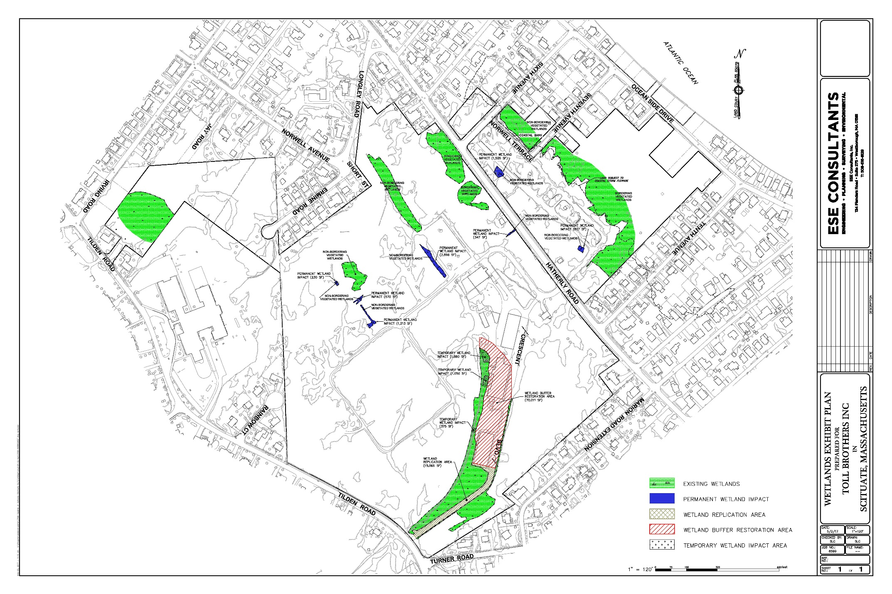

Slide 10
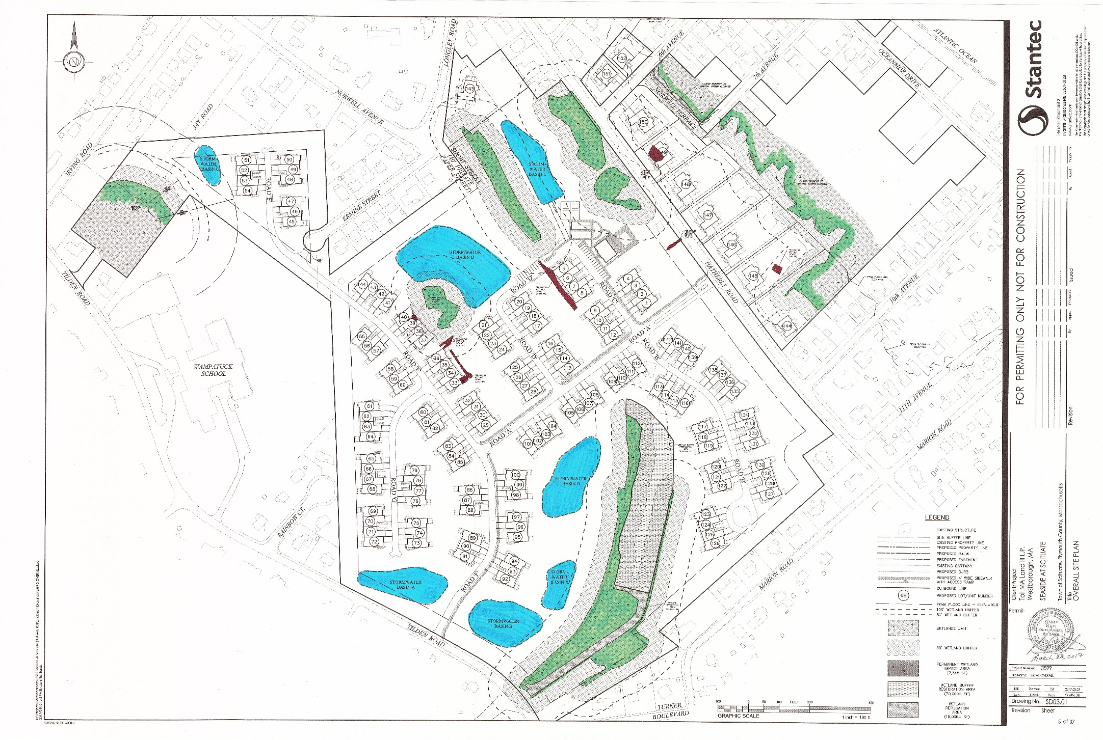

Slide 11
PROPOSED COMMUNITY

