Slide 1
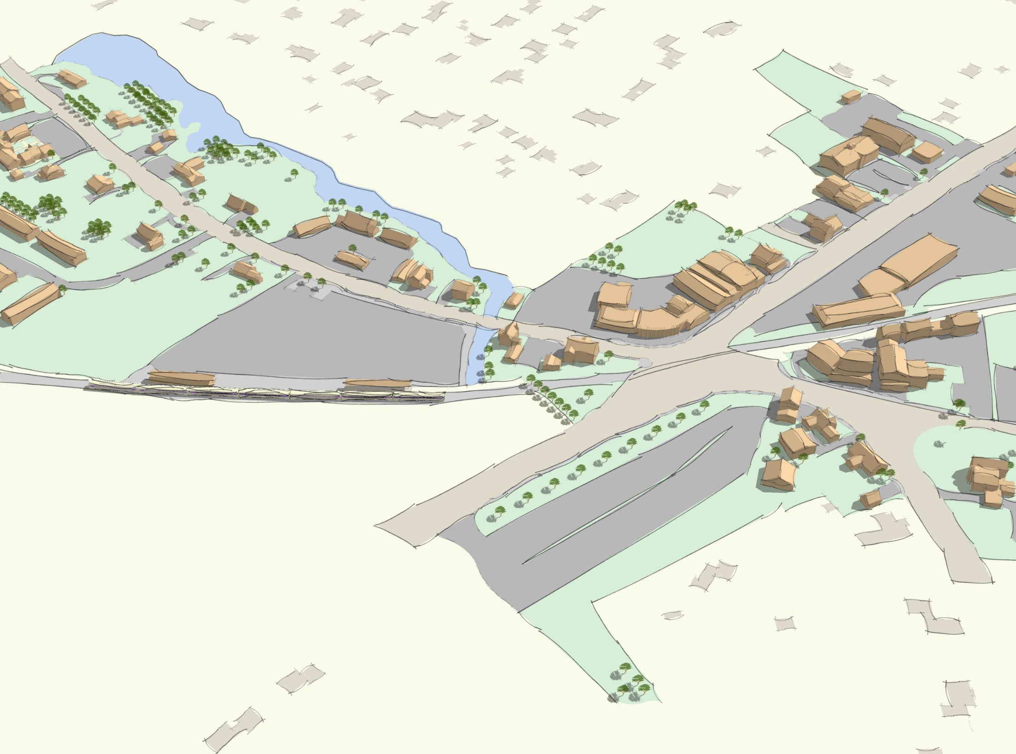
North Scituate Village Center Zoning
November 20, 2019

Slide 2
Project Overview
Review North Scituate Vision Plan
Draft zoning
Public feedback
Town Meeting

Slide 3
Study Area
GANNETT RD
COUNTRY WAY
T
HENRY TURNER BAILEY RD

Slide 4
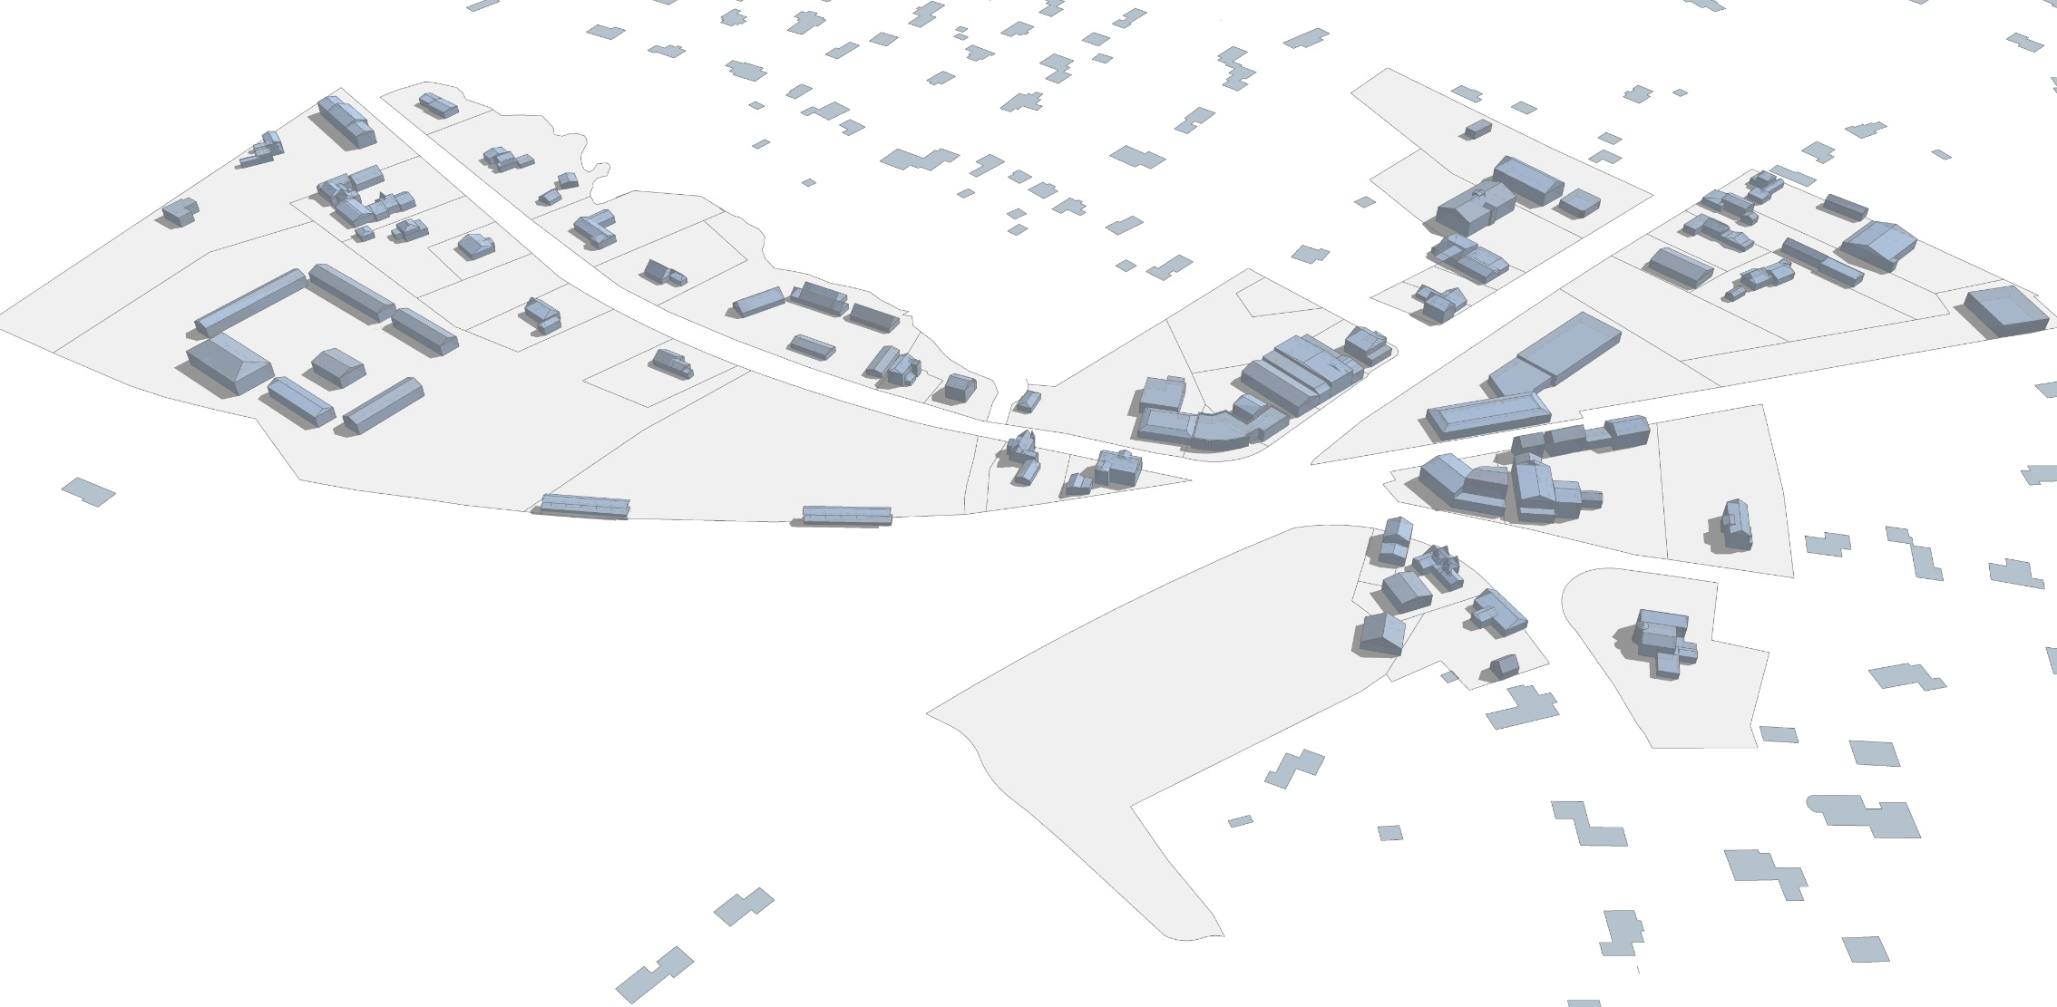
Study Area
GANNETT RD
COUNTRY WAY
T
Parcels: 49
Total Size: 36 acres
Building area: 135,000 SF
Floor Area Ratio: 0.09
Housing Units: 26
Employees: ~300
Daily Station Boardings: 335
HENRY TURNER BAILEY RD

Slide 5
North Scituate Village Vision
GENERAL GOAL FOR NORTH SCITUATE VILLAGE CENTER
Grow as an active, vibrant neighborhood center through the redevelopment of underutilized and vacant properties, streetscape and civic space improvements, parking and access enhancements, and business development to serve and attract more local residents, commuters, and visitors, especially those who use the Greenbush line for work and leisure.

Slide 6
Example of future vision

Slide 7
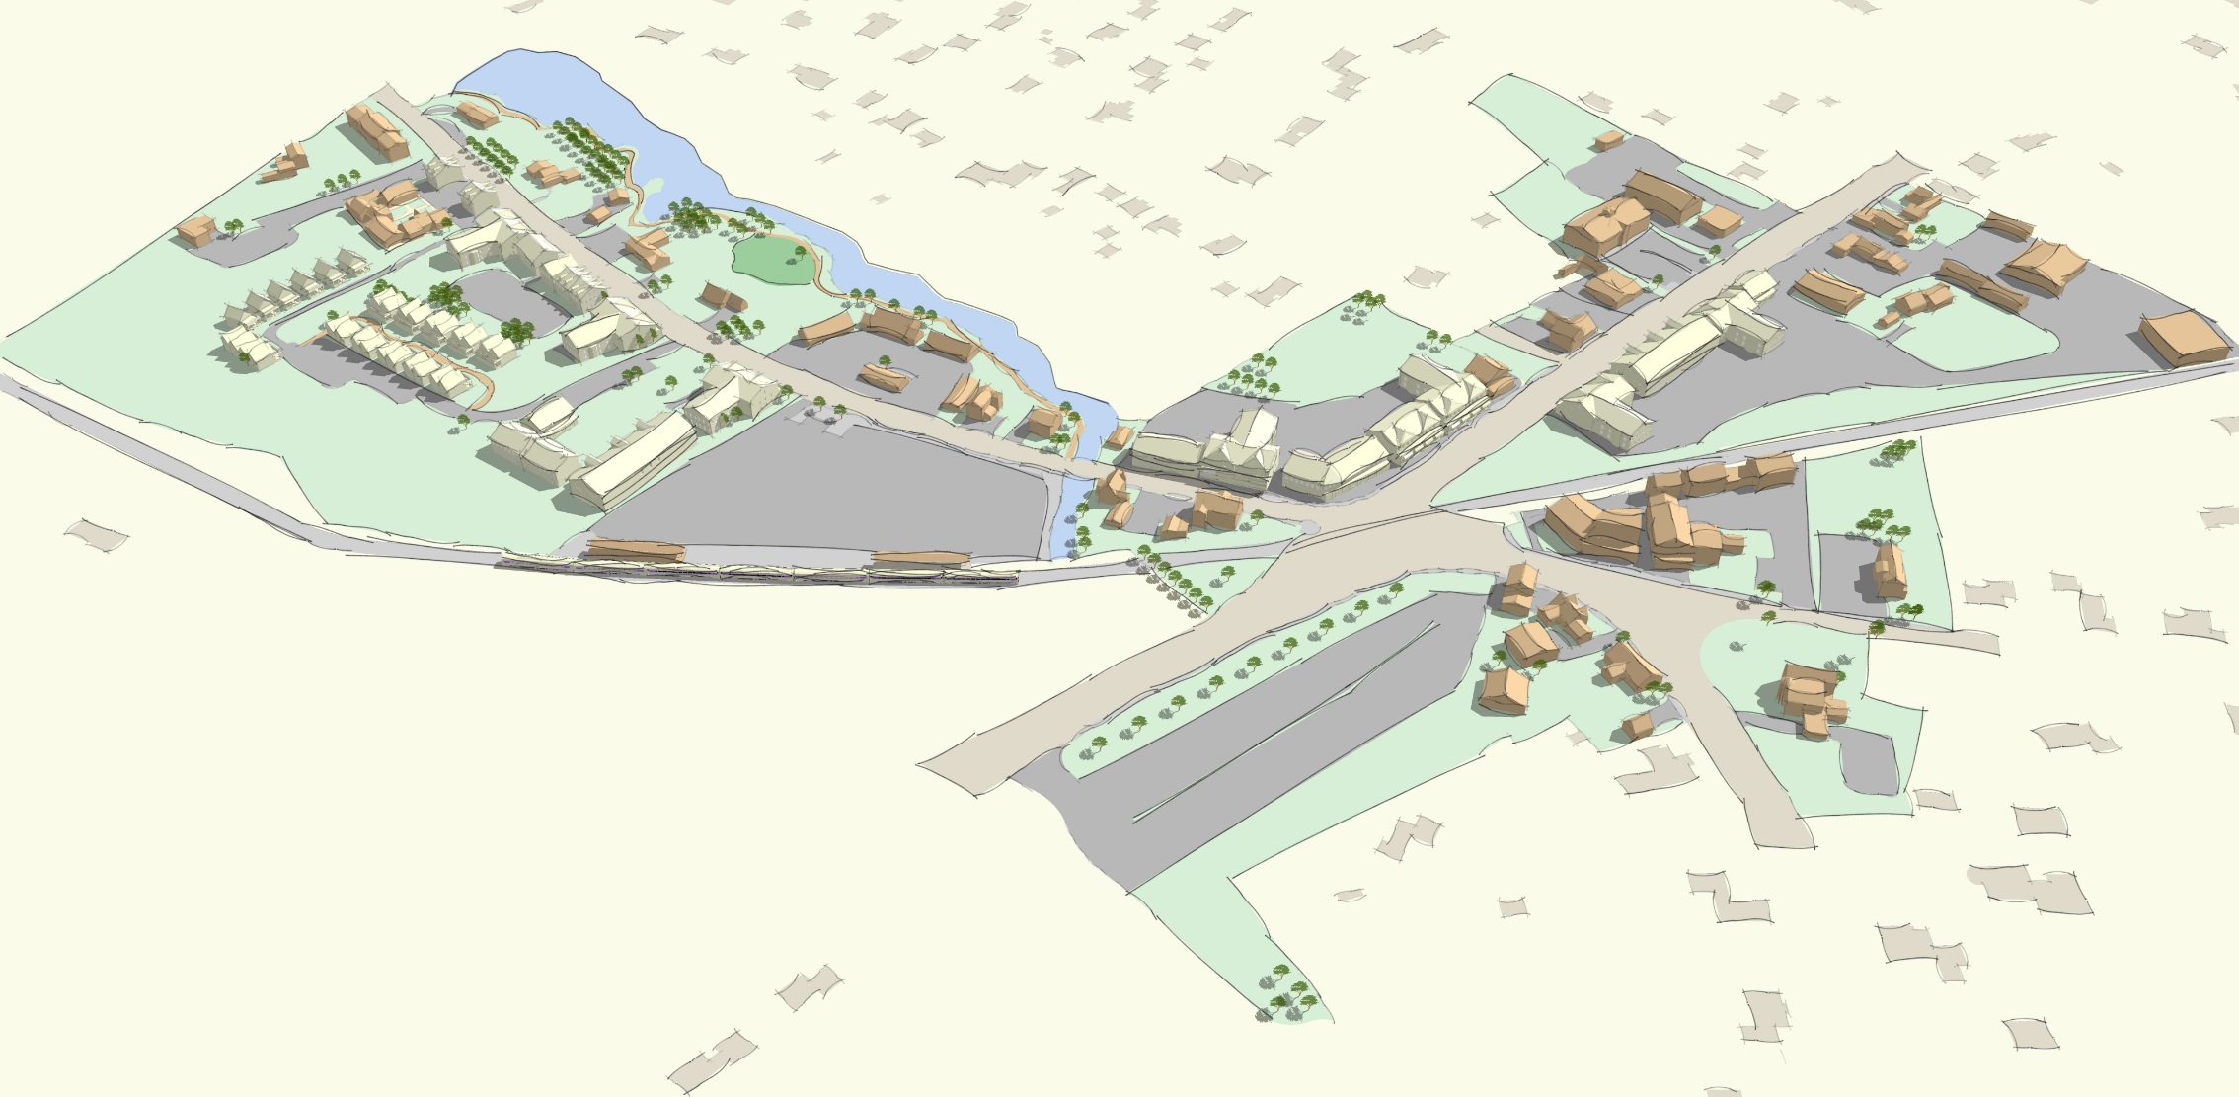
Example of future vision
Cottage clusters and additional residential development, supplementing additional commercial
Trails and improved access to nature
Commercial and mixed-use development, focusing on New England village principles

Slide 8
Recap from Public Forum
GANNETT RD
COUNTRY WAY
T
HENRY TURNER BAILEY RD

Slide 9
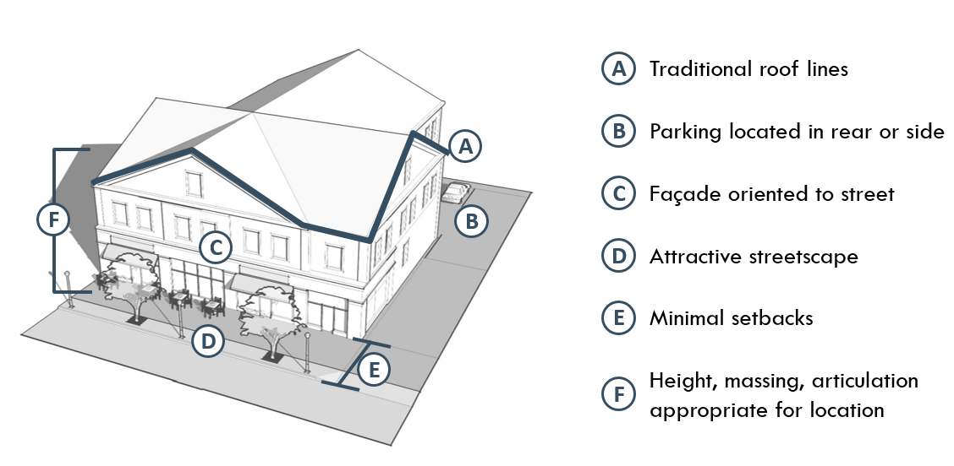

Slide 11
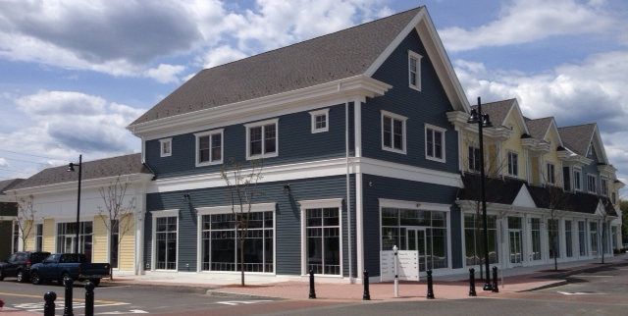

Slide 12
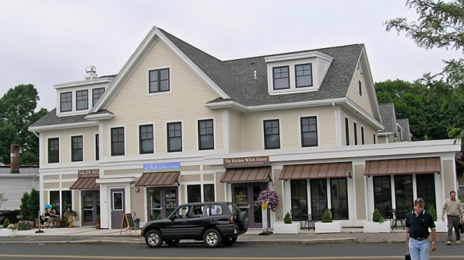

Slide 13
Proposed North Scituate Zoning
GANNETT RD
COUNTRY WAY
T
HENRY TURNER BAILEY RD

Slide 14
Village Center & Neighborhood Districts
North Scituate Village will be part of the Town’s VCN
VCN provides a framework for the Town’s villages
Adopted in spring 2019 Town Meeting (incl. Greenbush)
Promotes context-sensitive development that reflects scale, design, and uses appropriate for each village
Standards provide for:
Allowable building types
Design standards
Open space requirements
Roadway standards (if applicable for new streets)
Affordable housing requirements (if applicable)
Parking requirements

Slide 15
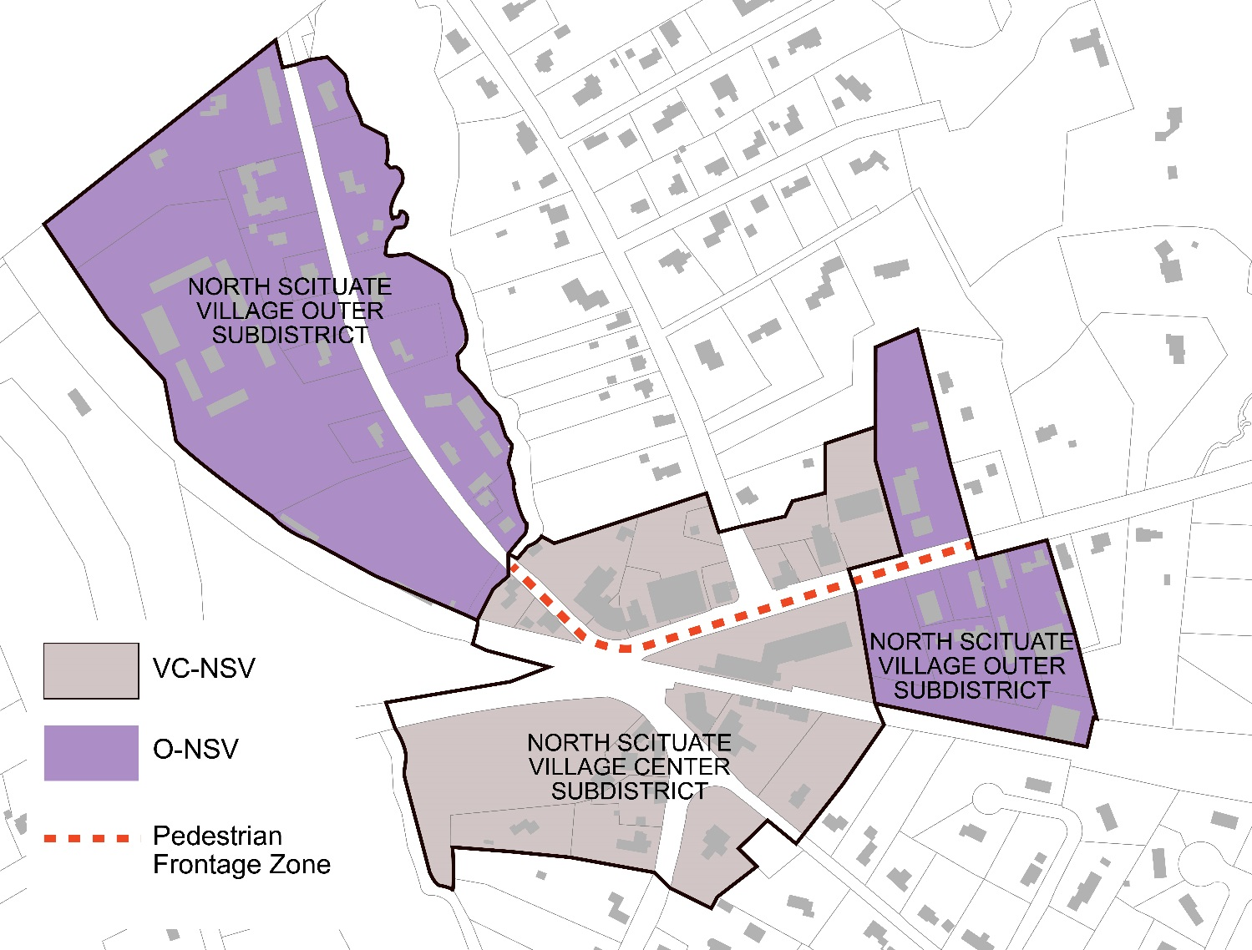
North Scituate Village Subdistricts

Slide 16
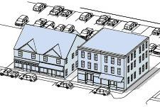
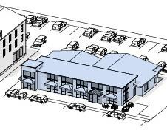
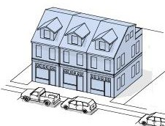
North Scituate Village Center Subdistrict
The “commercial core” of North Scituate Village. Intended to promote commercial activities, especially small businesses, allow mixed-use development, and encourage active forms of getting around.
Allowable building types
Mixed-Use
Ground-floor commercial with residential or office above
Commercial
Businesses on all floors; may be multiple businesses
Live-Work
A ground-floor business with the owner living above

Slide 17
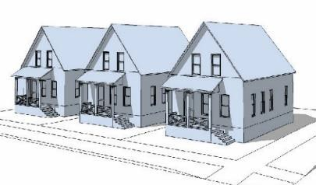
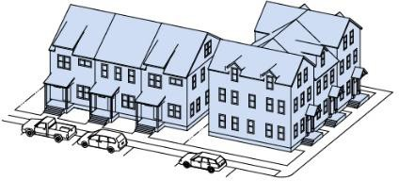
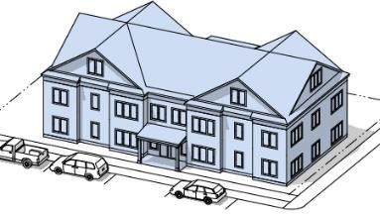
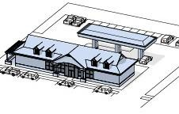
North Scituate Village Outer Subdistrict
Similar to the Village Center district but provides additional building types to promote housing, which can add vitality to the district and directly support Village businesses.
Allowable building types
Cottage Cluster
Small homes sited close together, typically around shard open space
Single Family Attached Townhomes and rowhouses
Multi-Family
Multiple residences in a building. Requires a special permit
Gas Backwards
A gas station with a site design more appropriate for a village, with pumps behind the building

Slide 18
Questions + Comments
CONTACTS:
Chris Kuschel, AICP
Senior Regional Planner
ckuschel@mapc.org
617 933-0731
Brad Washburn
Director of Planning & Development, Scituate
bwashburn@scituatema.gov
781 545-8868

