Slide 1
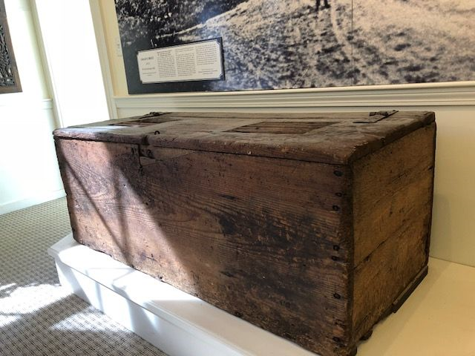
FY20 Scituate Historical Society - Historic Document and Artifact Preservation Projects
Item 1 Grain Chest 1650-1720
This is the only known example of a grain chest to survive from seventeenth century America. It is a toll chest, used for when millers took a portion of the corn they ground for payment instead of money. Once an extremely common form used in grist mills everywhere, grain chests have been lost due to moisture from rotting grain and infestation by rodents and insects. This grain chest also suffered from these hazards but is substantially intact. It is descended in the Stedman, Russell, Stockbridge, and Clapp families of Scituate, successive owners of the grist mill in Greenbush on First Herring Brook, now owned by the Scituate Historical Society.
The grain chest is constructed of 6 boards, 2 inch oak planks and 1 1/4 inch pine boards, held together with large wrought-iron spikes. The lid is mounted on heavy wrought-iron butterfly hinges and was originally locked by a heavy hasp and ring. The interior was originally divided into two compartments by a central partition, each of which was ventilated by five slots cut in the line. The economy with which the chest is constructed should not be interpreted as crudity. Although the form and its construction are not complex, it has been executed with precision, particularly the tight fit of the lid. It originally would have had smooth planed surfaces for cleanliness.
This chest was part of the exhibition New England Begins: The Seventeenth Century at the Museum of Fine Arts in Boston in 1982. The MFA’s curator for the exhibition oversaw repairs and fumigation of the chest at that time, and they made a replica of the chest for their collection. The chest has not had any preservation work since that time.

Slide 2
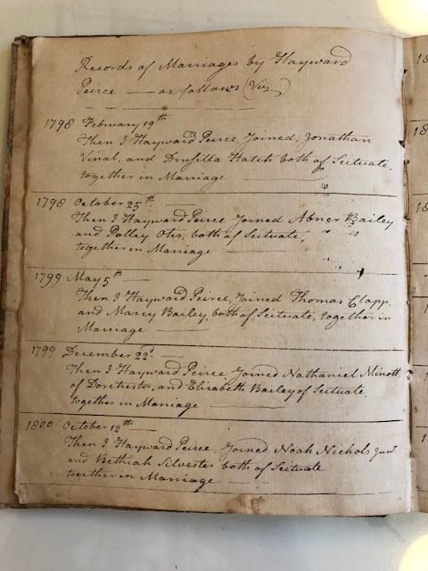
Item 2 Hayward Peirce Esq Marriage Records
Hayward Peirce Esq was the grandson of Captain Michael Peirce, who during King Philip's War led a group of mostly Scituate militia to Rhode Island (RI) in March, 1676 where they were massacred. Captain Michael Peirce was one of the first to die. (Deane' History of Scituate p. 120-124 and 326)
During the American Revolution Hayward Peirce Esq saw a lot of action early in the War in Massachusetts and RI. Several Litchfields from Scituate served under him during the Revolution. This was a description of his military service in a book, General Ward's Colonial Army, by Keith Brough and Frank Gardner:
First Lieutenant Hayward Peirce, son of Benjamin, Jr. and Jane Peirce, was born in Scituate, September 22, 1753. He held this rank in Captain Samuel Stockbridge's (from Scituate) Company, Colonel John Bailey's Regiment, April 19, 1775. May 10, 1776 he was commissioned Captain of the 6th (Scituate) Company in Colonel John Cushing's Second Plymouth County regiment. December 10, 1776 he marched as Captain in Colonel Jeremiah Hall's regiment for service in Rhode Island and served three months and two days. In September, 1777 he was Captain of a company in Theophilus Cotton's First Plymouth County regiment for service in Rhode Island.
Peirce served in the Massachusetts General Court as a Representative of Scituate in 1792, 1809, and 1812-1814, during the War of 1812, which impacted Scituate. As a lawyer he could perform marriages and this log is a record of the marriages he performed from 1798 to 1822.

Slide 3
Item 3 Temperance Movement and Scituate Sons of Temperance Meeting Minutes
In the decades before the Civil War, many forces, including a religious revival known as the Second Great Awakening, combined to make the period one of spiritual revivalism and social reform. Social reformers took on many of the perceived evils of American society including slavery, inequality of women, the poor quality of public education, inhumane treatment of the mentally ill, and alcoholism. There is no question that the citizens of Scituate were affected by and active in this period of reform, especially the anti-slavery and temperance crusades.
The consumption of alcohol among adults had skyrocketed in the early nineteenth century and alcoholism had become a major problem across the United States by the 1820s. Many reformers of the period saw alcoholism as the biggest obstacle to maintaining order and morality in the young nation, seeing a direct correlation between alcohol and other forms of vice, and as a danger to family stability. In response, temperance reformers organized the American Temperance Society in 1826 to spread the movement nationally and within a decade had 5000 branches and over a million members. Temperance reformers pledged not to touch the bottle, and canvassed their neighborhoods and towns to encourage others to join their “Cold Water Army.” The movement was a great success. By the 1840s Americans drank half of what they had in the 1820s, and per capita consumption continued to decline over the next two decades.
The first effort toward reducing the consumption of alcohol in Scituate began in the 1830s with the advent of Unitarianism to the First Parish and the ministry of Rev. Edmund Q. Sewall. One newspaper account reported that he led a series of meetings in the spring of 1833 that led to over 300 Scituate residents signing a pledge to abstain from alcohol. At the same time one Scituate merchant stopped selling alcohol, while another promised to stop his sale of alcohol once his current supply ran out.
South Parish in South Scituate under the pastorate of another Unitarian minister, Rev. Samuel Joseph May, was even more active in promoting temperance. At the time he came to Scituate in 1836 Rev. May was very active in the American Total Abstinence Society and in Scituate “he found a wide field of labor” for temperance. He soon organized Scituate’s own “Cold War Army” enlisting nearly 500 children from all over the town, who marched through the streets with banners, music, and proclaiming their battle cry: “So here we pledge perpetual hate, to all that can intoxicate.”
In the 1840s the temperance movement created a new organizational format of fraternal societies. The largest of these was an order founded in New York City in 1842, the Sons of Temperance. The Sons spread rapidly. By 1850 it had “divisions” in 23 states and close to 250,000 members. By the 1850s Scituate had its own “division” of the Sons of Temperance, which met once a week at Union Hall. The Sons provided material support to reformed men and their families with a regular system of contributions and benefits. There was an initiation fee and weekly dues which funded sickness and death benefits, but only to members who remained in good standing. The Sons had a policy of secrecy to avoid the liabilities of public exposure. Members were admitted by vote of existing members and adhered to strict rituals in conducting weekly meetings. The Town appeared very supportive of the Sons of Temperance renting out Union Hall to them for a fee of $1 for the year in 1862.
The Scituate Historic Society is fortunate to have a journal of the minutes of the Scituate Sons of Temperance meetings from 1851-1855. These minutes provide a tremendous insight into the Sons, pulling open the curtain on what was a secret organization. From these minutes we can determine who were the members of the Sons in Scituate, how they carried out their mission, what issues they confronted, and the practical concerns of their funding and paying benefits to members.

Slide 4
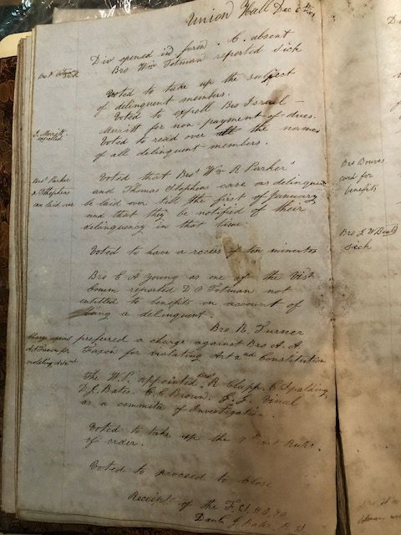
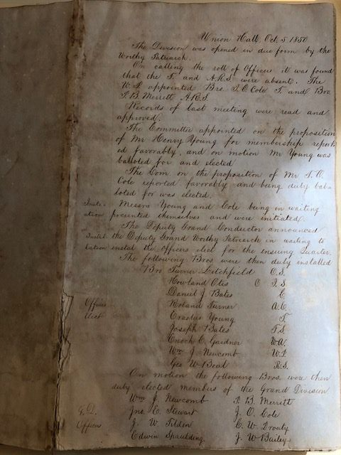

Slide 5
Item 4 & 5 Instrument of Protest Logs 1807-1898
The owners of vessels and cargo did not typically escort their interests to their destinations so the responsibility to initiate the claims process for loss or damage fell to the master of the ship. Once arriving at port the master would file an “Instrument of Protest” before a notary public or other qualified official. The Instrument of Protest would describe all the circumstances surrounding the loss: ship origins, cargo, planned destination, the date, the time, the setting and striking of the sails, descriptions of the weather, and details of specific damages, including crew illness, injuries or death. The Instrument of Protest provided an insurer with the information required to properly evaluate a claim. Instruments of Protest provide a first hand account of all the significant wrecks and storms that occurred along Scituate's coastline.
These logs tell us what ships wrecked off of Scituate and the details of the circumstances under which the losses occurred. They are extremely rare and highly valued by historians for the detailed data they provide. One of the logs also has a section on school records from the 1850’s. Following is an excerpt from our Massachusetts Humane Society display at the Maritime & Irish Mossing Museum that shows the kind of information that is provided by the entries.
Instrument of Protest – H. J. Hanson, Master of the Brig Wellamo 25 April 1851
A multi-day storm began on April 14th with a violent northeast wind that turned into a tremendous gale with an extraordinarily high tide. This storm is known as the “Lighthouse Storm” because during the worst of the storm on April 16th the first Minot’s Light was destroyed, toppling into the sea, sending 2 lighthouse keepers to their death.
Another tragedy occurred on the same day on the Russian Brig Wellamo which was en route from Cadiz, Spain to Boston with a load of salt, wine, and cork when they encountered the perilous storm. One seaman was lost overboard, 2 others were thrown into the scuppers and disabled, and the remaining mariners sought safety in the rigging only to have rush back down to the deck when the ship was thrown onto one side. The vessel drifted and struck the beach near Fourth Cliff. Some of the men escaped the ship and “took shelter in the Charity House, which had been stationed on the beach to afford shelter to shipwrecked mariner.” The Scituate Charity House on Fourth Cliff was the first house built for the use of shipwrecked men by the Humane Society of Massachusetts.
Item 6 Scituate Town Reports
Several hundred people visit the Laidlaw Center each year to research their ancestors and local history. We are open 6 days a week to serve the public. One key frequently used resource is our collection of Scituate Town Reports from 1846 to the present. We would like to bind our collection of Town Reports to preserve this important resource for visitors’ use. We understand the reports are available at the Town Archives and online at the Town Library, however, the Town Archive is only available if they visit on a Wednesday morning and the online reports at the Library can only be used if the visitor has brought a computer with which to access their site – we do not provide technology resources at the Laidlaw .

