Slide 1
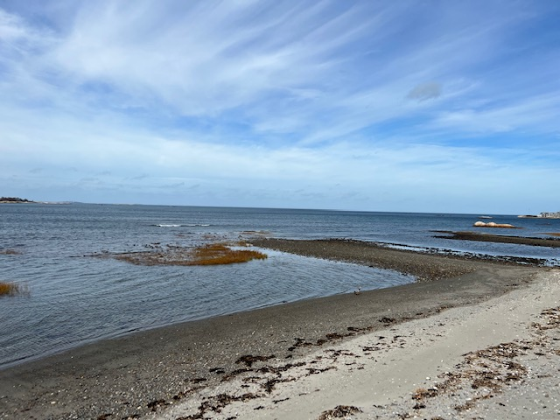
2023 Aquaculture Proposal
Scituate Shellfish Advisory Committee
January 10, 2023

Slide 2
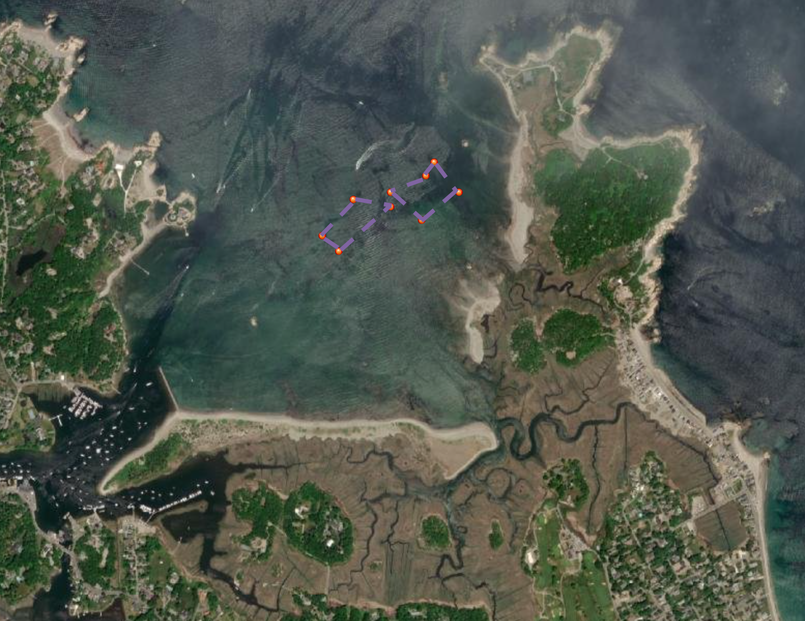
Scituate Lease Sites (two, 5-acre sites)

Slide 3
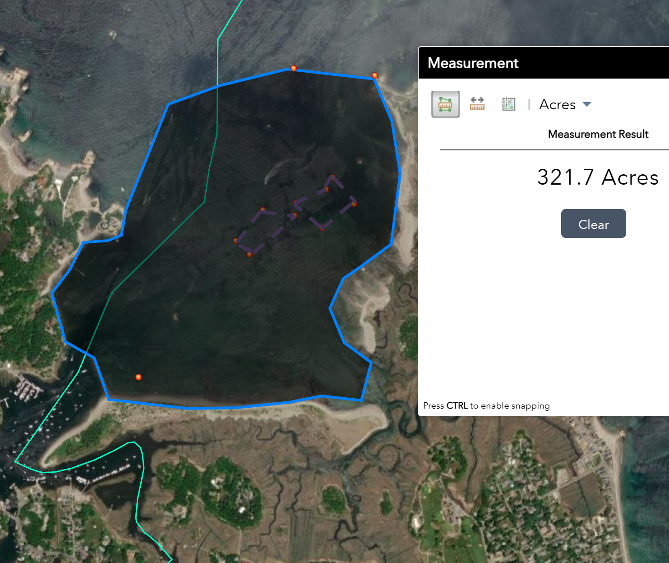
320+ Acres Scituate and Cohasset Waters

Slide 4
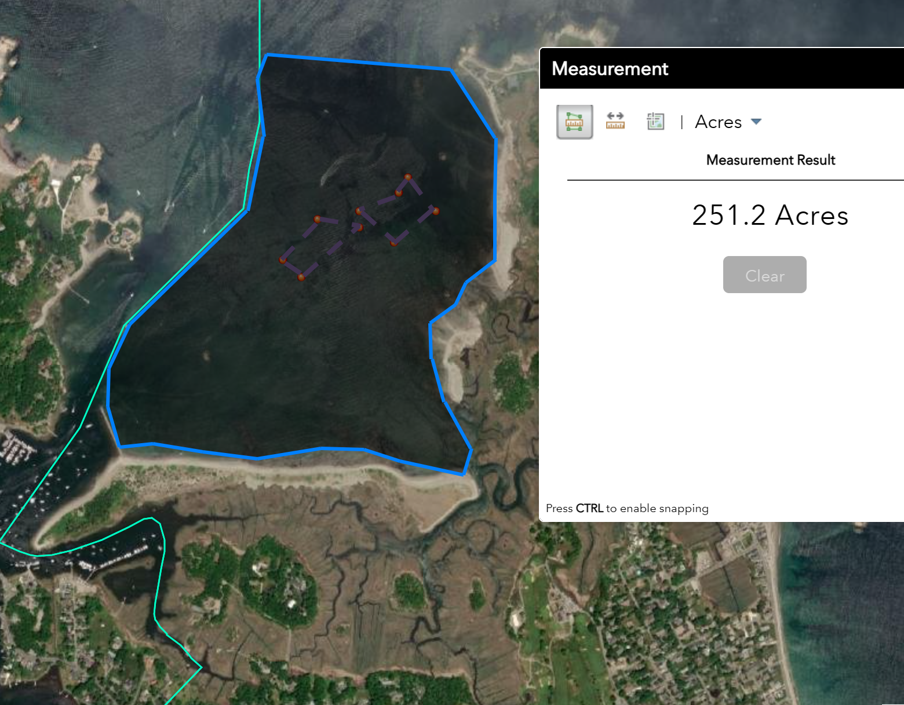
Over 250 Acres Scituate Waters

Slide 5
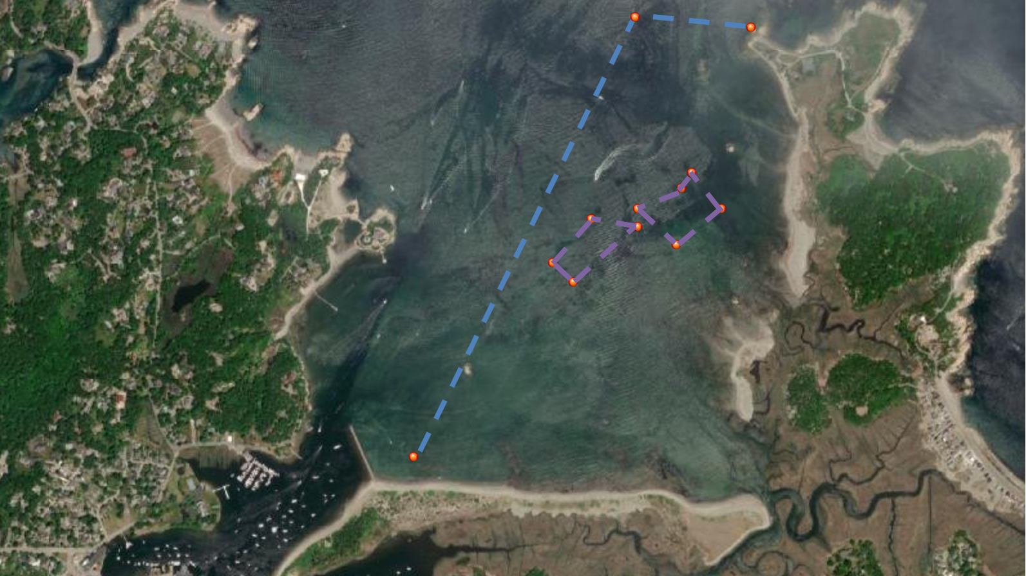
MB 10 Scituate

Slide 6
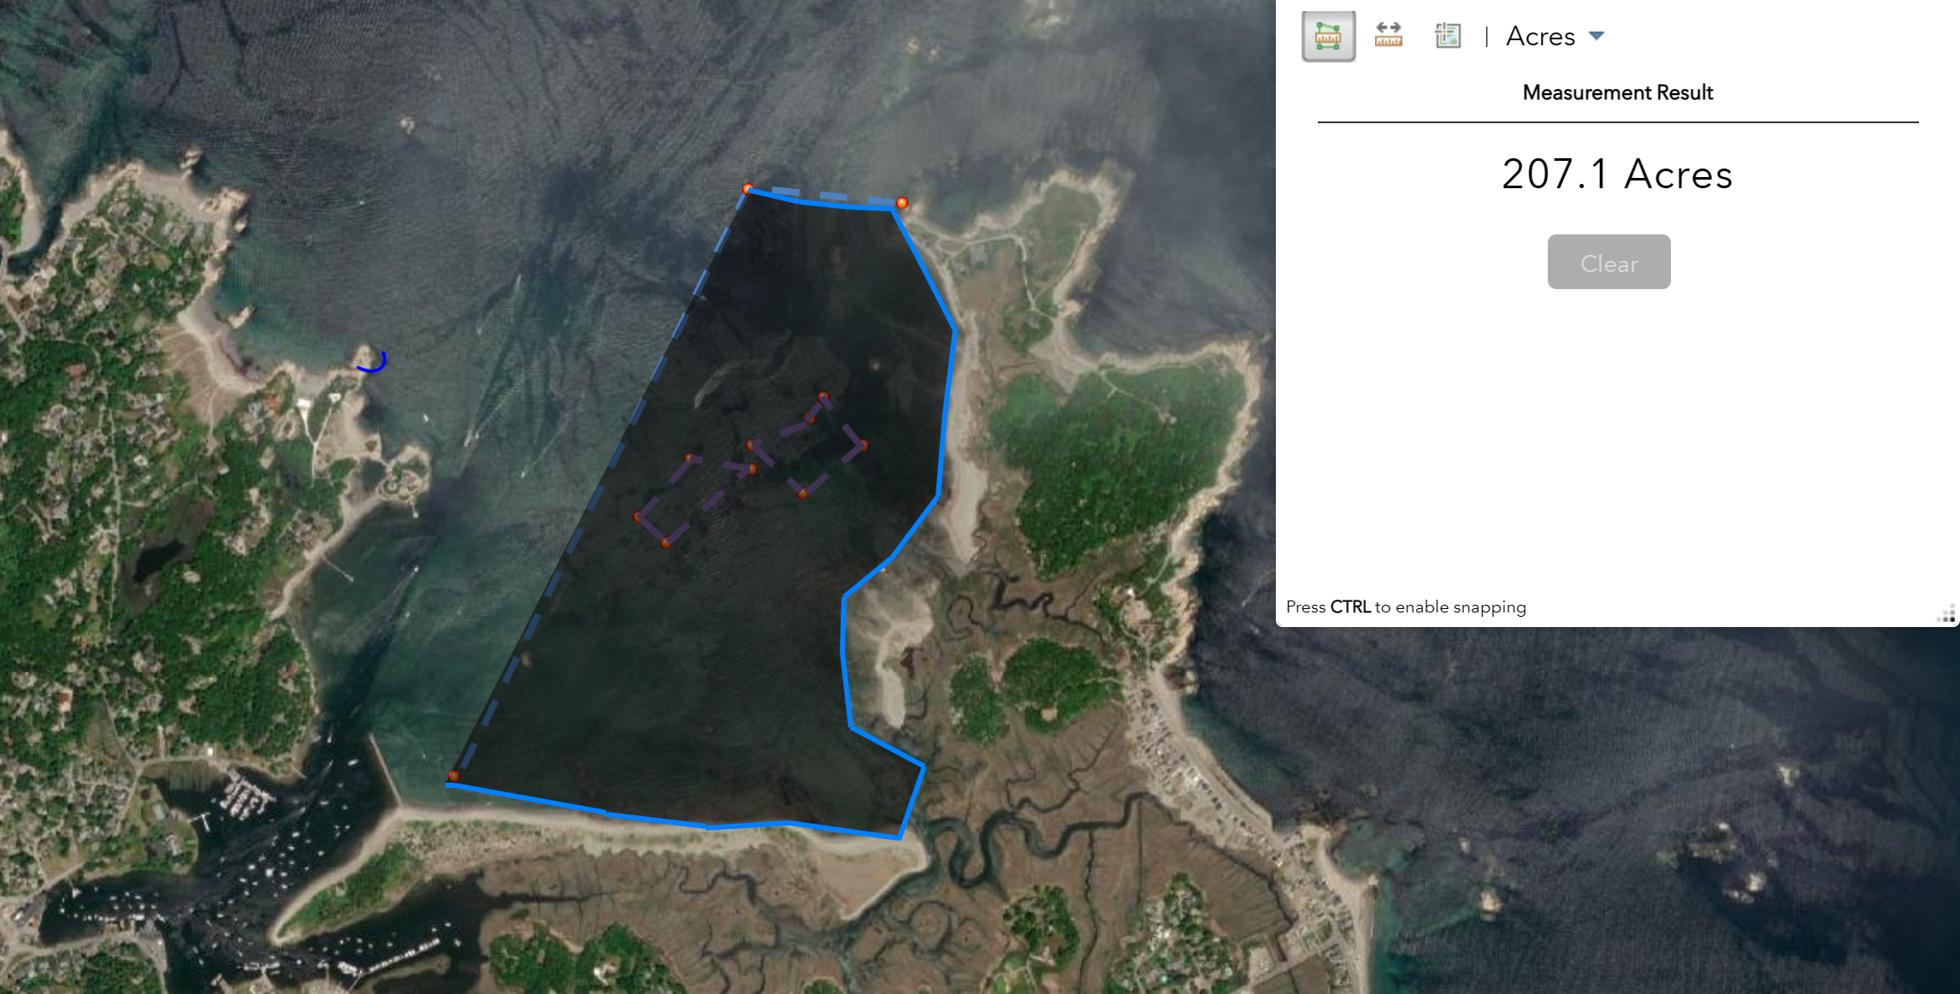
200+ Acres Shellfish Waters in Scituate (MB10)

Slide 7
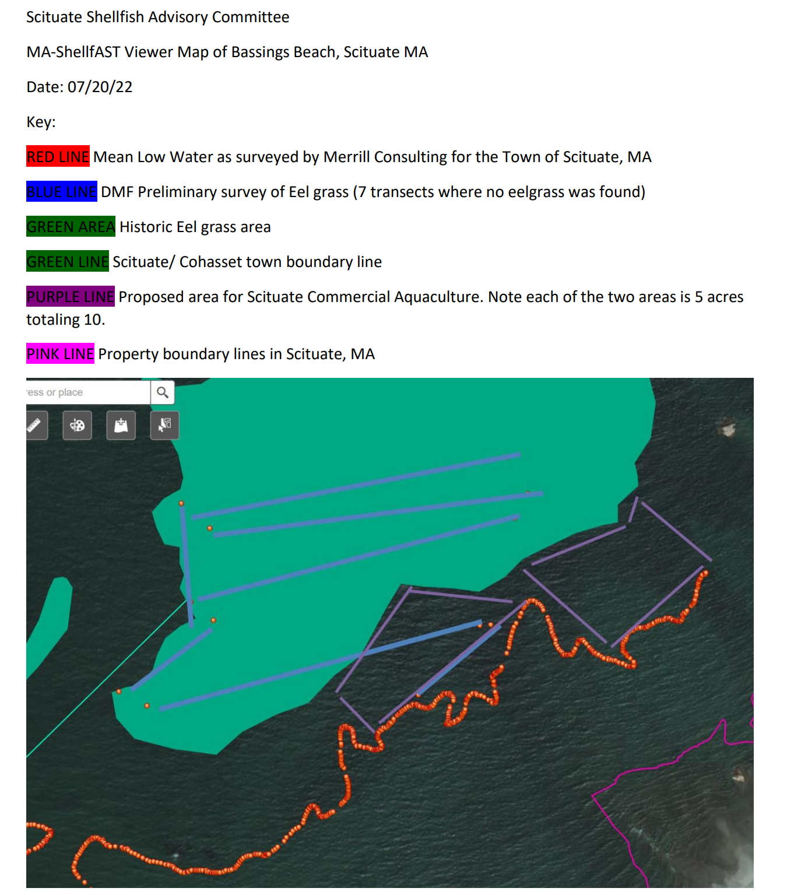
Proposed Location
Source SAC Website

Slide 8
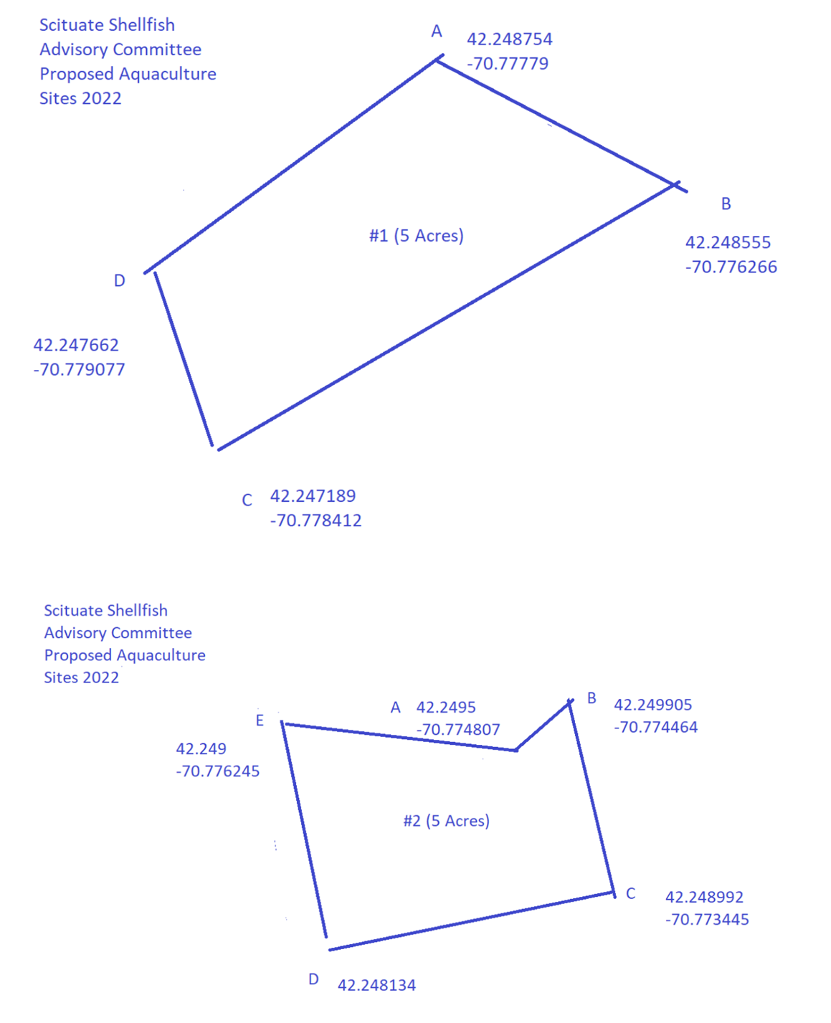
Lease Site Coordinates

