Slide 1
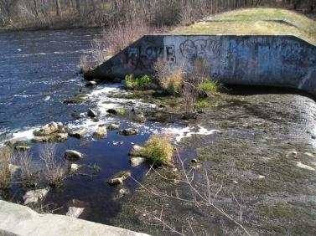
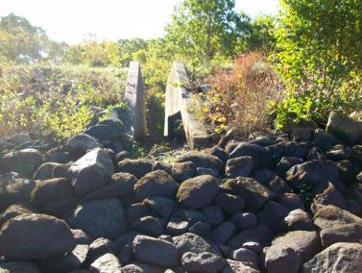





Scituate Reservoir Dam Water Storage
and Fish Passage Improvements Project
January 15, 2019 Public Meeting
Project Team

Slide 2
Project Goals
Increase Scituate’s Drought Resiliency
Provide adequate seasonal stream flow for native aquatic species
Effectively operate fish ladders to restore the herring run
Notes:
Monitoring began in mid-2000’s

Slide 3
Previous Studies 2011 - 2017
  2011 Water Evaluation and Planning (WEAP) modeling
      Leads to streamflow releases, irrigation restrictions
  2012 Preliminary Assessment
    Id Reservoir options; OOB fishway repair design
  2013 Reservoir and Fish Ladder Improvement Feasibility Study
    Investigated feasibility/impacts of raising reservoir
    Repaired Old Oaken Bucket fish ladder
  2014 Preliminary Reservoir and Fish Ladder Design (30%)
  2017 60% Design and Initial Permitting
Notes:
biggest challenge: fish passage at the Reservoir

Slide 4
2018-2019 – 90 % Design and Permitting
Environmental Impact Report
90% Design Drawings and Specifications
Permit Applications
Operating and Maintenance Manual
Future Phase - Bid and Construction
Bid Requirements
100% Design Drawings and Specifications
Construction and As-built Drawings

Slide 5
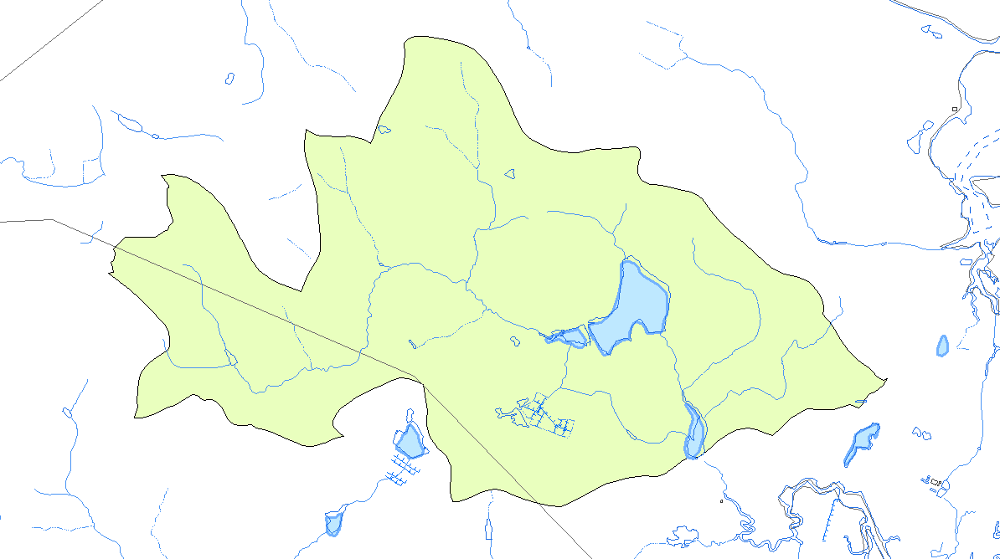
First Herring Brook Watershed and Water Supply
Current avg. winter demand is 1.26 mgd
Unrestricted summer demand in past has been up to ~2x
~73% of water supply for Scituate comes from the First Herring Brook watershed
23% comes from surface water in offseason, 51% in summer
4.3 square mile drainage area
Groundwater Wells
Surface Water Withdrawal
Stream Gauges

Slide 6
Proposed Reservoir Dam Modifications
Raise maximum normal pond levels to El. 40.4 ft
- 1.5 ft above existing spillway crest (El. 38.9 ft)
- 23% increase in storage capacity; 108.8 ac-ft (35.4 million gallons)
- Same level as existing high water
- Minimal change in typical spring levels (12 inches ± above spillway crest)
Lower spillway crest 2.5 ft and install bottom-hinged gate
- No reduction in spillway capacity
- Automatic gate control from Water Treatment Plant
Modify existing fishway for downstream passage
- Install spillway bottom-hinged crest gates
- Lower fishway exit channel and install removable weirs
- Install low flow notches on fishway weirs
Fishway exit channel elevation: 3.9 ft below existing channel (El. 38.9 ft)
- Spring – El. 40.4 ft to El. 38.5 ft min. depending on inflow
- Fall – El. 37.2 ft to El. 36.4 ft min. depending on inflow

Slide 7
Reservoir Dam Impoundment Water Level
TOM starts here
INSERT FIGURE 1

Slide 8
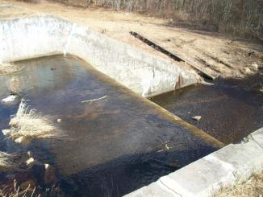
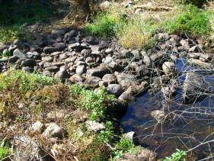
Spillway Modifications
Spillway bottom hinged crest gate
Lower Spillway Crest
s
Entrance channel improvements

Slide 9

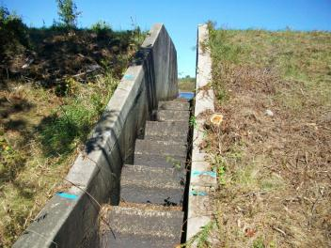
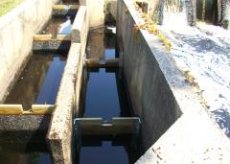
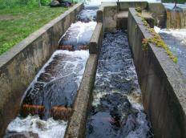
Fishway Modifications
Fishway exit channel modifications
Fishway weir modifications

Slide 10
2017 Project Costs
2017
Contractor Mob/Demob $ 111,000
Temporary Construction Facilities $ 31,000
Spillway Modifications $ 704,000
Fishway Modifications $ 239,000
Infrastructure Upgrades $ 131,000
Subtotal $1,216,000
Contingency $ 122,000
Subtotal $1,333,000
Design and Permitting $ 353,000
Construction and Administration $ 104,000
Total Project $1,795,000

Slide 11
Funding from State Grants for this Project To Date
2013 - $68,180 (SWMI, DER)
2014 - $54,500 (SWMI)
2017 - $115, 250 (SWMI)
2018 - $227,309 (EEA Dam and Seawall)
Total state $ received $465,239
Match from Scituate and parnters for these grants was ~20% with inkind

Slide 12
Proposed Operational Plan
Reservoir normal pool elevation at 41.5 ft (1.5 above existing)
Town water demand same as existing (~1.5 MGD annual average excluding Humarock)
Reservoir fish ladder streamflow needs
Aquatic habitat releases
Outdoor water ban trigger
Streamflow cutoff threshold
Adaptive management tool will use weekly data on water supply status and drought condition plus any anomalies to provide guidance on streamflow release and demand management
Notes:
Reservoir ladder outlet elevation is 36 ft

Slide 13
WEAP Model Scenarios
Baseline (Current Condition) Updates
  Well 17 discharges to Old Oaken Bucket Pond instead of directly to water treatment plant
  100,000 gallons per day less groundwater (more surface water) used on an annual average
Well 17 Discharge Redirected to Tack Factory Pond, as planned by the Town
Ice Pigging, which began in 2018 and is expected to continue into the foreseeable future.
Notes:
The goals of the current modeling effort are to update the baseline scenario to reflect slight changes in operations since the last iteration, evaluate the effect of Well 17 redirection, account for new ice pigging water use, and refine an understanding of how to balance water conservation impacts on residents with environmental impacts through the Outdoor Water Ban and streamflow cutoff triggers. Both the current dam configuration and the new dam configuration are being reviewed.

Slide 14
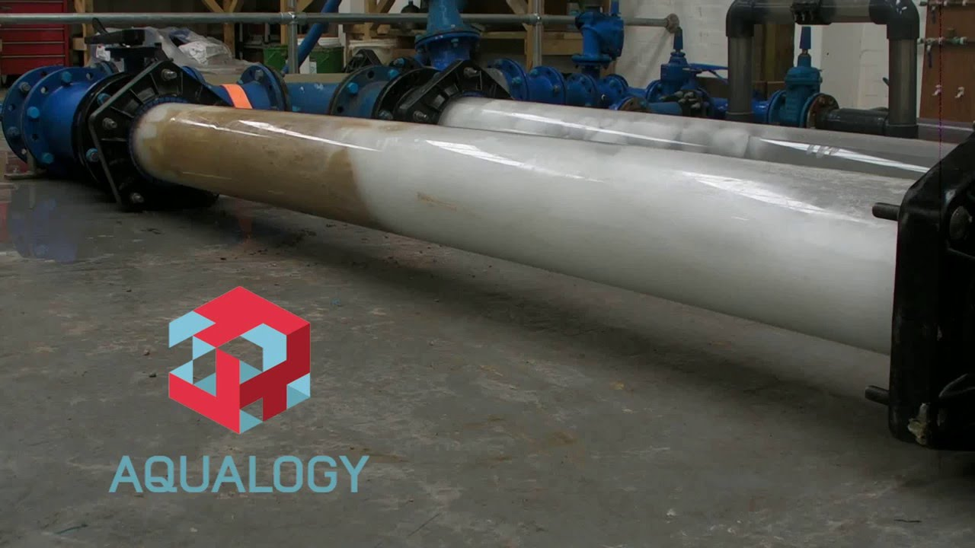
Ice Pigging
Ice pigging consists of using a controlled application of ice pellets in a watermain that has been temporarily removed from service to clean out material that has deposited over time. This material contributes to the discolored water you may have experienced.
Suez UK, www.youtube.com
Test of Ice Pigging on oil and sand contaminated pipeline

Slide 15
WEAP Model Scenarios (continued)
Baseline (Current Condition) Updates
  Well 17 discharges to Old Oaken Bucket Pond instead of directly to water treatment plant
  100,000 gallons per day less groundwater (more surface water) used on an annual average
Well 17 Discharge Redirected to Tack Factory Pond, as planned by the Town
Ice Pigging, which began in 2018 and is expected to continue into the foreseeable future.
Alternate Stream Flow Cutoff Threshold captures 3 worst droughts, not just the drought of record
Alternate Outdoor Water Ban Trigger level to balance impact on residents and environmental impacts
Current & Future Reservoir Full Storage Elevations

Slide 16
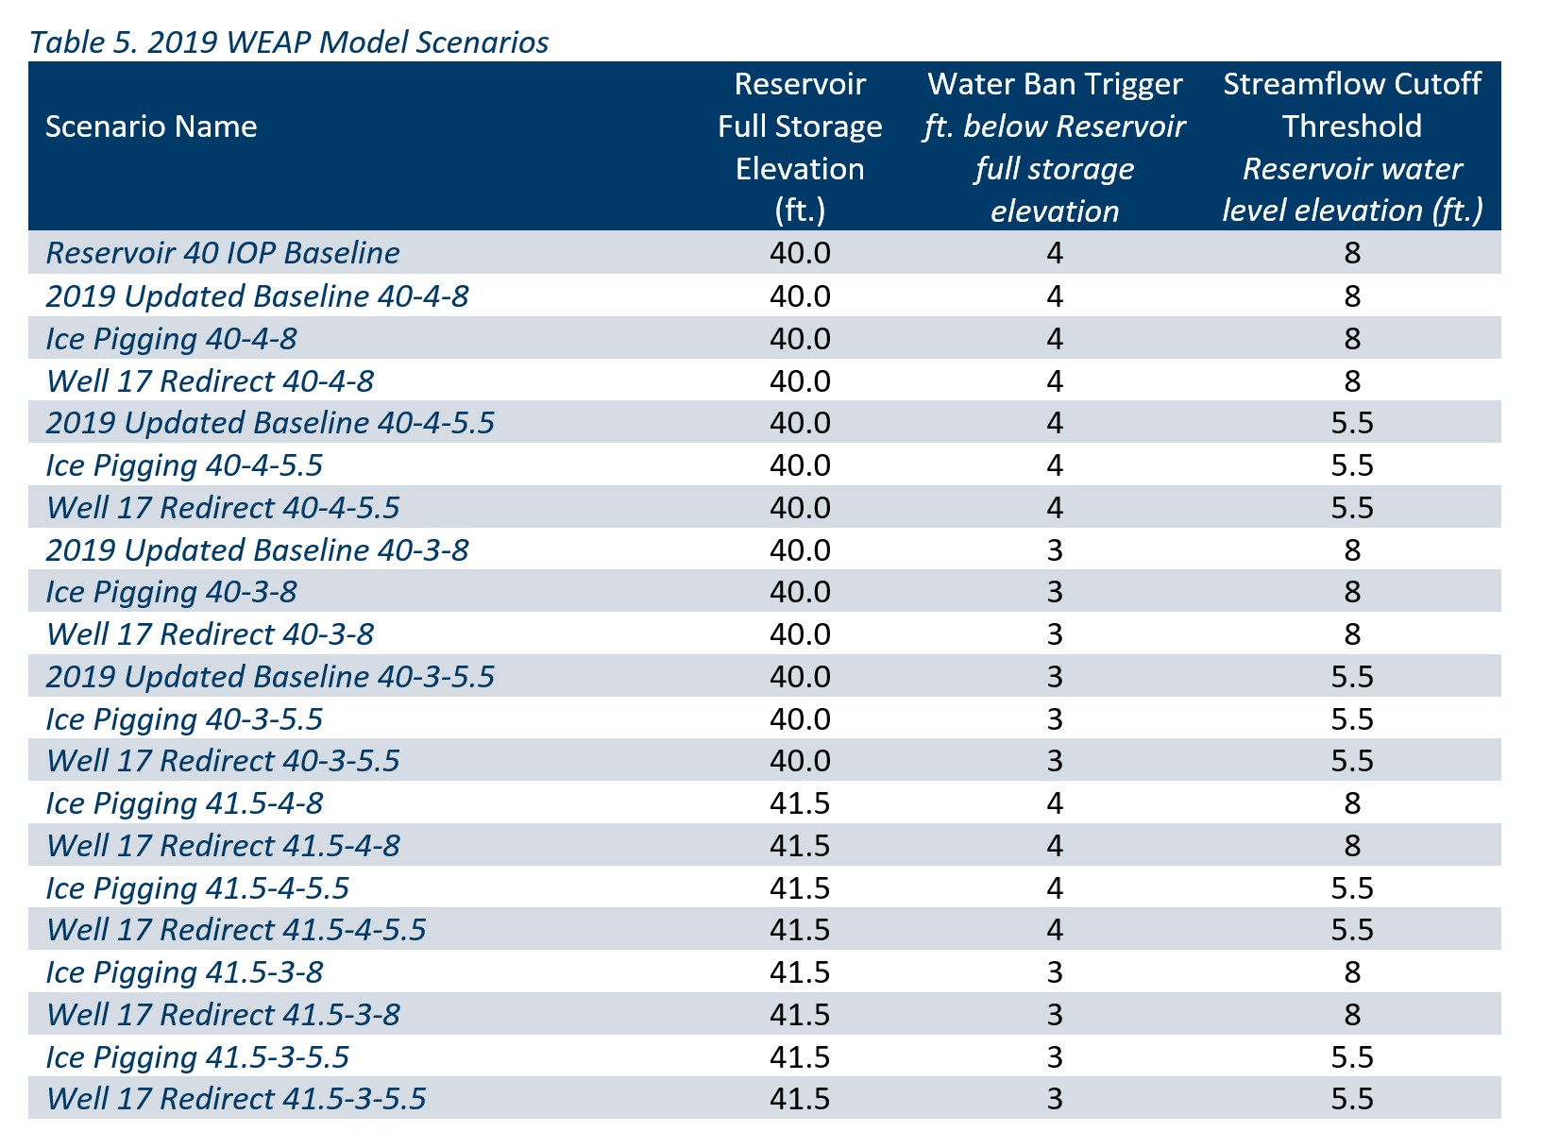
WEAP Model Scenarios
Notes:
Once you take into account all the various combinations, this works out to 21 scenarios. Note that the Water Ban Trigger (when we go into a total outdoor water ban) and the Streamflow Cutoff Threshold (when we cut off streamflow out of the reservoir) are varying in these along with the conditions under which the water supply is being operated. Examining these variables and the impacts allows us to know how successful we can be in meeting all the needs – i.e. water demand and habitat requirements

Slide 17
Scituate Water Conservation Plan 2016
Accomplishments to date
Prohibited new connections of inground irrigation systems to the Town's water supply
Used water rates and connection fees to improve system reinvestment
Improved collaboration with the CPC and all other committees to protect water resources
Water conservation tips circulated through Town emails and website
Rain barrels available for purchase through the Town and WaterSmart

Slide 18

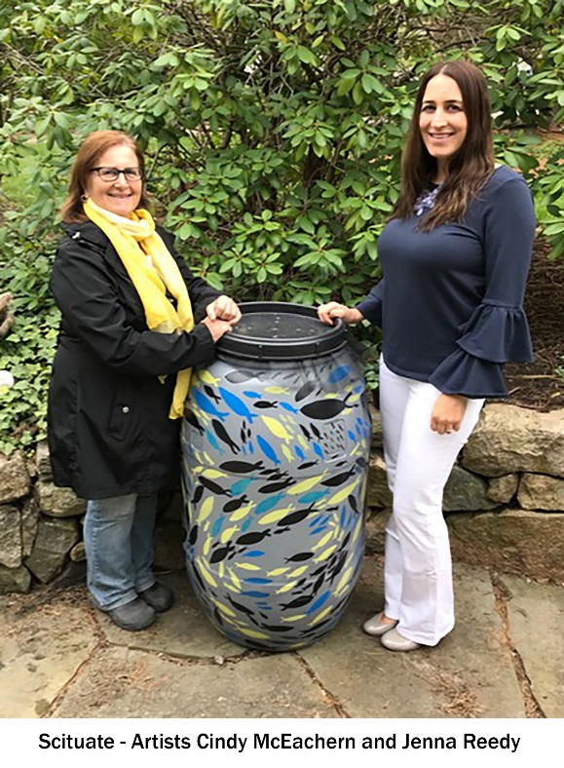

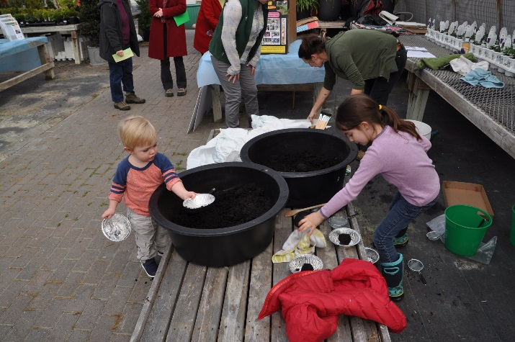

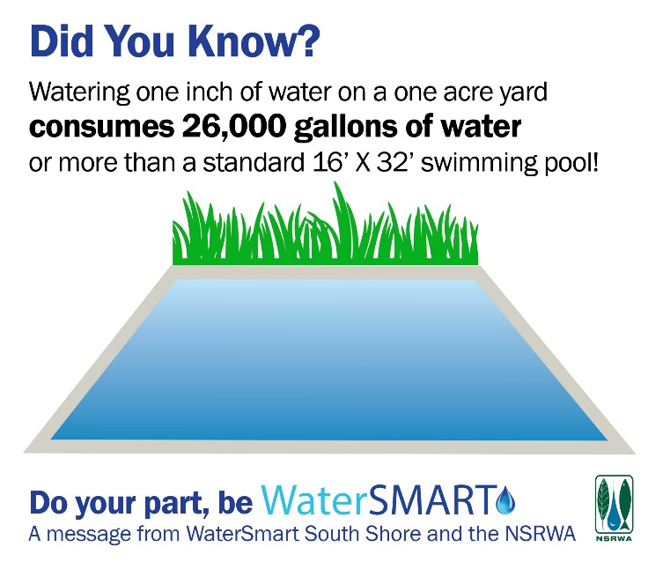
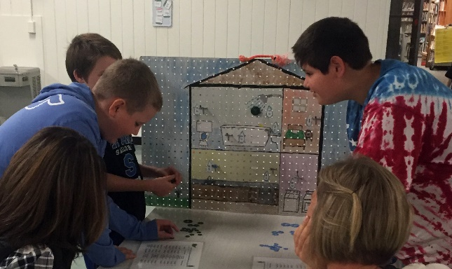
Notes:
The town of Scituate participates in the regional WaterSmart South Shore program through the North and South Rivers Watershed Association. This regional program provides education and outreach on water conservation. Programs include rain barrel awareneww

Slide 19
What’s Next for Water Conservation?
Continued education around brown water and all other water resource issues that face Scituate, Ongoing
Encourage stronger enforcement of irrigation rules and restrictions, Ongoing
Continue replacing water meters with smart meters that can be read on a more regular basis, Ongoing
Require 1 water meter per unit for all new developments, Q1 2019

Slide 20
What’s Next for Water Conservation?
Present water offset policy to the Water Commissioners / Board of Selectmen, Q2 2019
Create BMP's for school facilities, such as playing fields and parking lots, Q2 2019
Water conservation event and tours of the Water Treatment Plant, Q2 2019
Promote reuse of treated wastewater in new buildings, Q3 2019
Require water efficient fixtures and waterwise landscaping to be incorporated into the design of public facilities, Q4 2019
Obtain better information on summertime water demand and population increases to target conservation, 2019-2020?

Slide 21
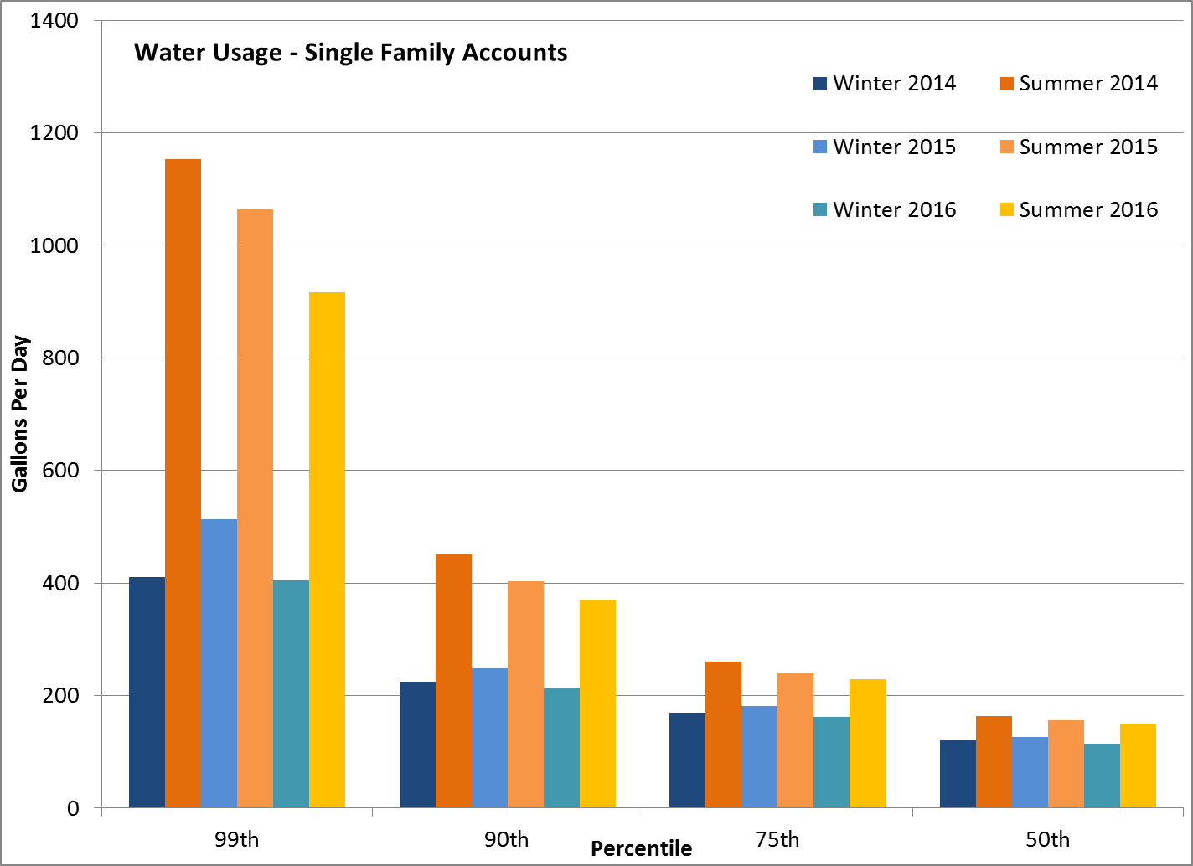
Impacts of Outdoor Water Ban on Usage

Slide 22
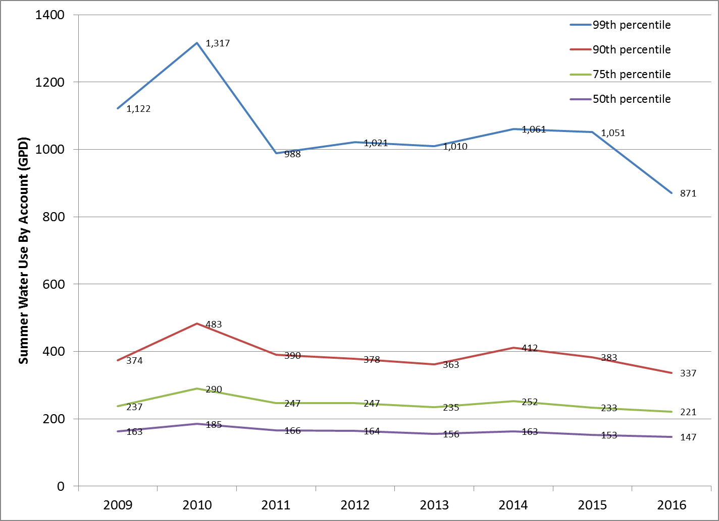
Impacts of Outdoor Water Ban on Usage

Slide 23
Water Supply Benefits of Additional Storage
Water supply storage increased 23%; 108.8 ac-ft (28 days additional storage, or 35.4 million gallons)
Same water supply delivered while providing environmental flows for fish and stream habitat
Greater resiliency to drought and emergencies (fires, loss of groundwater well power)

Slide 24
Ecological Benefits
Restores 70 acres of pond for alewife and American eel and access to stream habitat upstream of the reservoir for blueback herring
Maintains reservoir at a more constant level provides more shoreline habitat for alewife:
11,800 ft at El. 38.9 ft
15,500 ft at El. 40.4 ft
Estimated median carrying capacity of Reservoir Dam impoundment is 25,000-30,000 alewife

Slide 25
DRAFT ENVIRONMENTAL IMPACT REPORT
Certificate of the Secretary of Executive Office of Energy and Environmental Affairs (EOEEA #15711) based on review of Environment Notification Form (ENF)
Mandatory Environmental Impact Report addressing:
- Groundwater levels
- Reservoir level increases on adjacent properties,
CJCH, and wetlands vegetation
- Update of Firm Yield Analysis
- Spillway discharge capacity
- Alternatives considered

Slide 26
2014 GROUNDWATER MEASUREMENTS

Slide 27
SHORELINE ASSESSMENT
Shoreline
No change in high water level El. 40.4 ft
Water Supply Protection District Buffer Zone
No change in Town’s 150 ft Water Protection District
Septic Systems
Septic systems adjacent to reservoir currently meet DEP Title V regulations except one abandoned property;
Monitoring indicates treatment systems properly functioning
Stormwater Management
Construct bioswale at end of Sherman Drive to treat road runoff discharging to reservoir

Slide 28
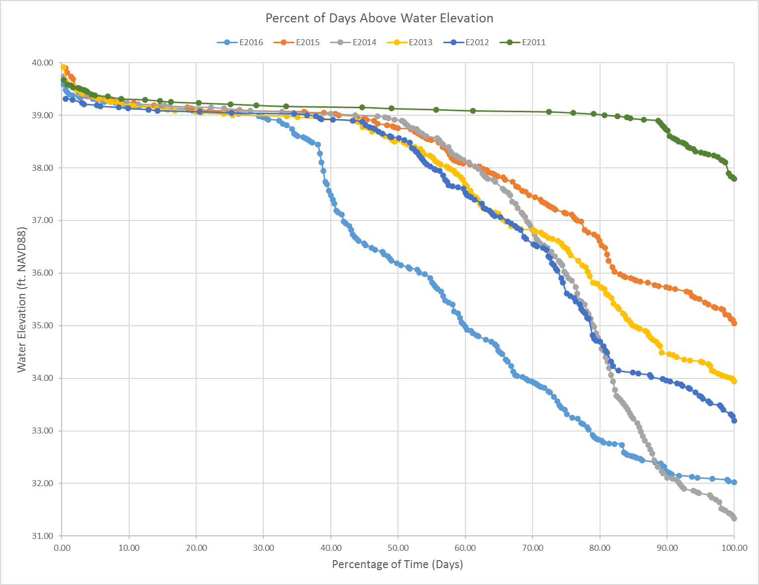
DPW RESERVOIR LEVEL MEASUREMENTS

Slide 29
2018 WETLANDS VEGETATION STUDY
Met with DEP at Tack Factory Pond (10-10-18)
Transects flagged and wetlands species identified in field (December 2018)
Desktop study of wetlands plants characteristics
Existing and proposed wet/dry cycles for wetland plants based on WEAP model

Slide 30
WETLANDS VEGETATION STUDY TRANSECTS

Slide 31
FIRM YIELD ANALYSIS
“Refinement and Evaluation of the Massachusetts Firm-Yield Estimator Model Version 2.0” (SIR2011-5125) published by U.S. Geologic Survey
Water Management Act (WMA) Amendment
Firm Yield is maximum rate of water withdrawal for a reservoir

Slide 32
Water Sources and Losses to Reservoirs

Slide 33
HYDROLOGIC AND HYDRAULIC STUDY UPDATE
Update U.S. Army Corp of Engineers’ (USACE) Hydrologic Engineering Center (HEC) Hydrologic Modeling Software (HEC-HMS) model for watershed subbasins and Old Oaken Bucket
Dam failure analysis
Office Dam Safety (ODS) Permit

Slide 34
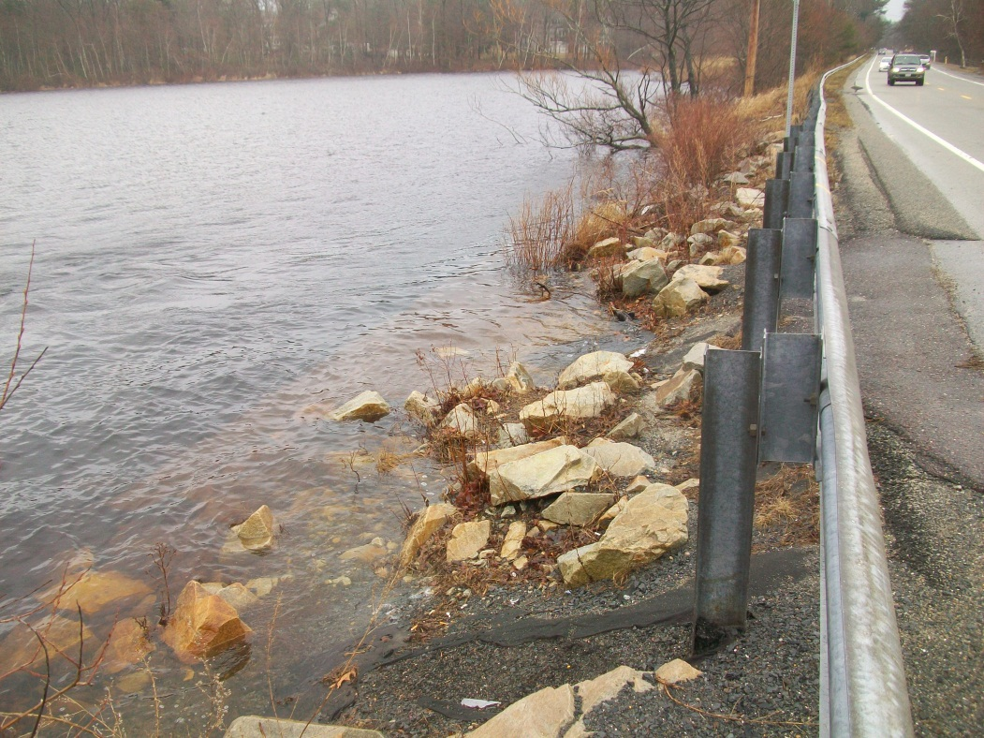
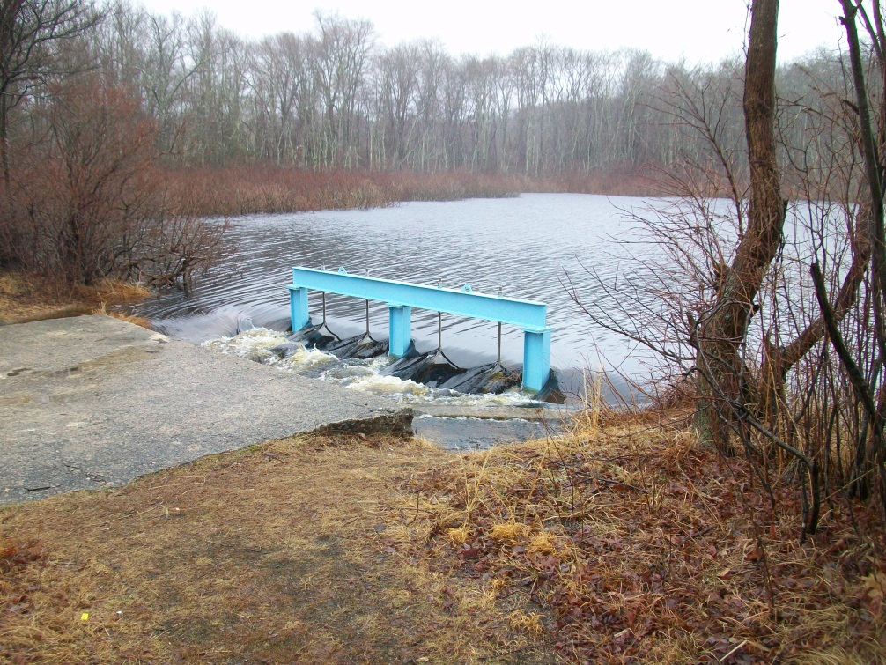
SHORELINE IMPROVEMENTS
Route 3A –
380 ft embankment erosion protection
Tack Factory Pond –
Raise gate and structure for access

Slide 35
PERMIT APPLICATIONS
Chapter 91 RDA
DEP Stormwater Management Consultation
NMFS Fisheries consultation
ODS EAP update
ODS Dam Safety Permit
DER Final Operational Plan Consultation
DMF Fishway Permit
DEP Section 401 Water Quality Certification
USACE Section 404 Category 2 Permit
DOT Access Permit and Consultation
DEP WMA Permit Amendment

Slide 36
90% Design
Update 60% design drawings
Prepare construction specifications
Access easements

Slide 37
Summary
90% design plans being worked on, permitting continuing
Town must make spillway improvements at reservoir dam to comply with state standards for flood control
Storage increased by ~35 million gallons or 28 days
Estimated project cost is $1.8 million dollars, $350,000 expended, ~$1.4 million to complete.

Slide 38
Summary
Restoring 70 acres of herring habitat by having enough water to run fish ladder effectively 97% of spring days and 79% of fall days (based on 2017 model)
No new area surrounding the reservoir will be flooded
We assumed similar water demand reductions as were obtained in 2016 drought (aka outdoor water ban 6% initial reduction and 25% reduction after enforcement and publicity in summertime demands).
Need to implement town’s water conservation plan to maintain current demand for this project to have all benefits

Slide 39
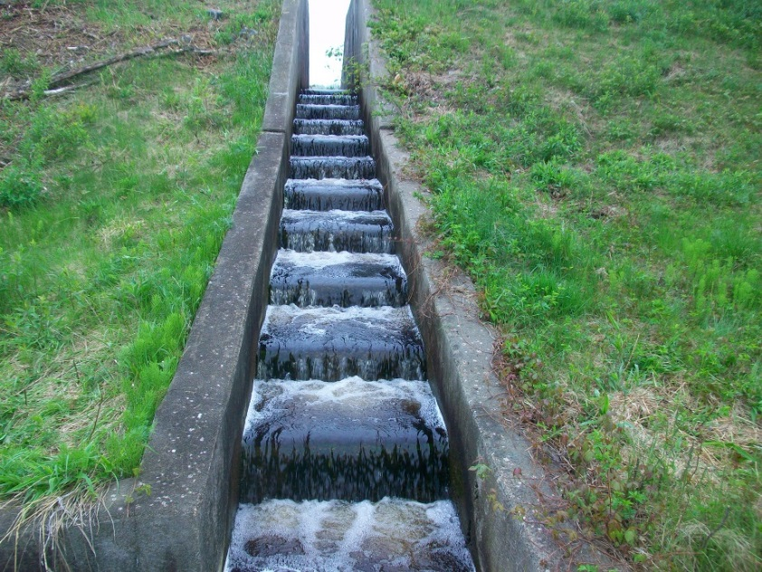
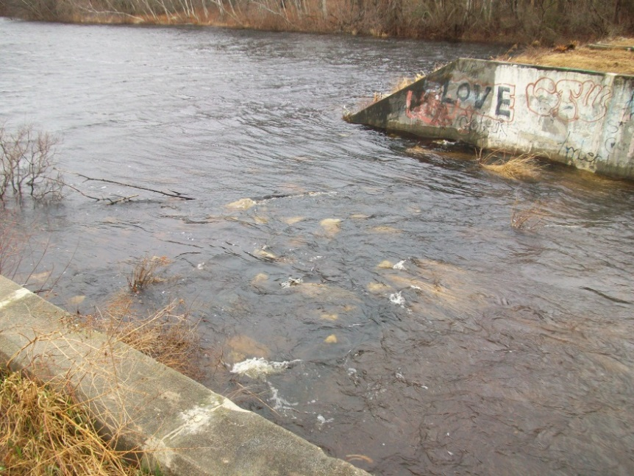
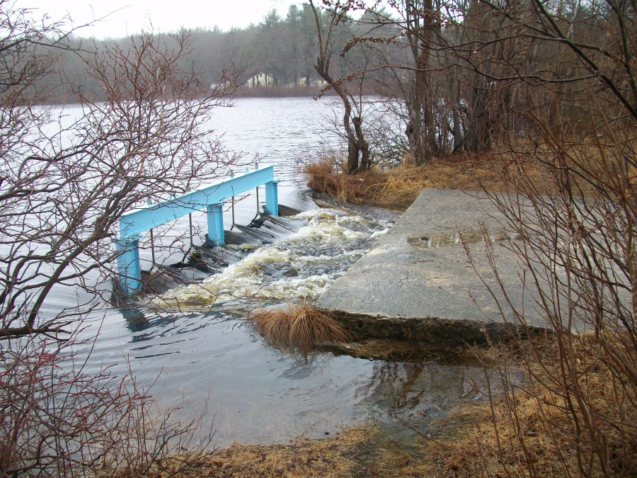
QUESTIONS ???
Next public outreach meeting – May 2019

