Slide 1
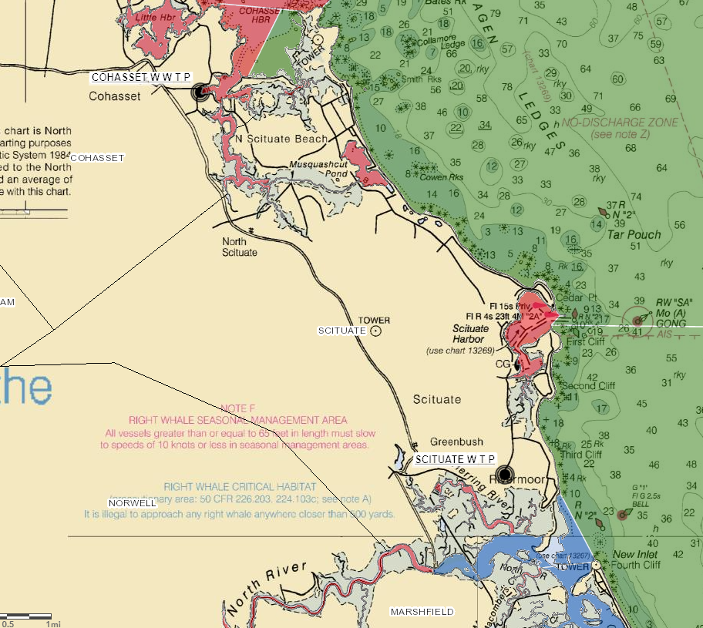
Shellfish Classification
adjacent to
Cohasset & Scituate
Wastewater Treatment
Plants
Scituate Shellfish Advisory Committee
Wednesday June 16, 2021

Slide 2
National Shellfish Sanitation Program (NSSP)
The NSSP regulates all harvesting, handling and processing of bivalve molluscan shellfish in the US. The NSSP is a product of the Interstate Shellfish Sanitation Conference (ISSC), a state-federal-industry partnership which meets every two year to review and update ‘the Guide.’
In Massachusetts the Division of Marine Fisheries (DMF) is the shellfish control authority for growing area classification. [DPH/FPP is the SCA for processing (plant sanitation) and OLE is the SCA for patrol.

Slide 3
Classification adjacent to Wastewater Treatment Plants
National Shellfish Sanitation Program (NSSP) Guidance States
Without modeled data or dye studies, states are required to set
Mandatory Closed Safety Zones at 1000 / 1 dilution line
Conditional area within 100,000 / 1 dilution line
Impacts
CSZ may impinge planned aquaculture sites (MB10) or may preclude all harvesting (MB5-6)
Reclassification to Conditionally impacts-interupts harvesting (MB10)
Conditional classification requires additional documentation and
monthly monitoring by DMF

Slide 4
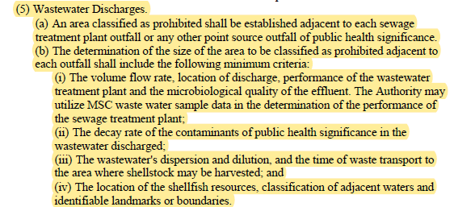

Slide 6
NSSP Sanitary Classifications
Approved Open to shellfish harvesting for direct human consumption subject to local rules and regulations. Closed only during major coast-wide events (e.g., hurricane, oil spill, red tide event).
Conditionally Approved Closed some of the time due to rainfall or seasonally poor water quality or other predictable events. When open, it is treated as an Approved area.
Restricted Contains a limited degree of contamination at all times. When open, shellfish can be relayed to a less contaminated area or harvested for depuration.
Conditionally Restricted Contains a limited degree of contamination at all times, subject to intermittent pollution events and may be closed some of the time due to rainfall or seasonally poor water quality.
Prohibited Closed to the harvest of shellfish under all conditions, except the gathering of seed for municipal propagation programs under a DMF permit.

Slide 7
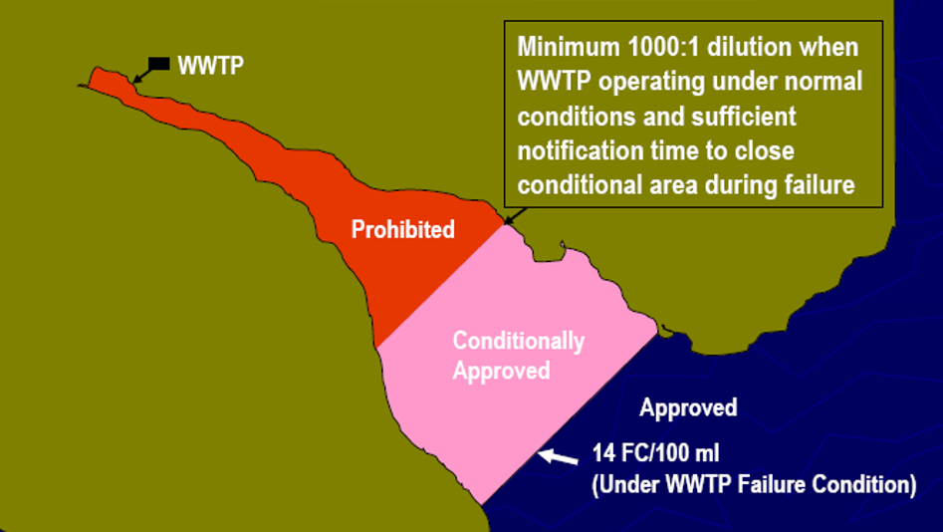
For Example

Slide 8
Why follow recommendations?
Public Health Protection
Massachusetts signatory to the Interstate Shellfish Sanitation Conference (ISSC)
Both DMF and DPH have adopted the NSSP Model Ordinance by reference in regulation
Avoid non-compliance finding by FDA
Massachusetts could be prevented from exporting product inter-state

Slide 9
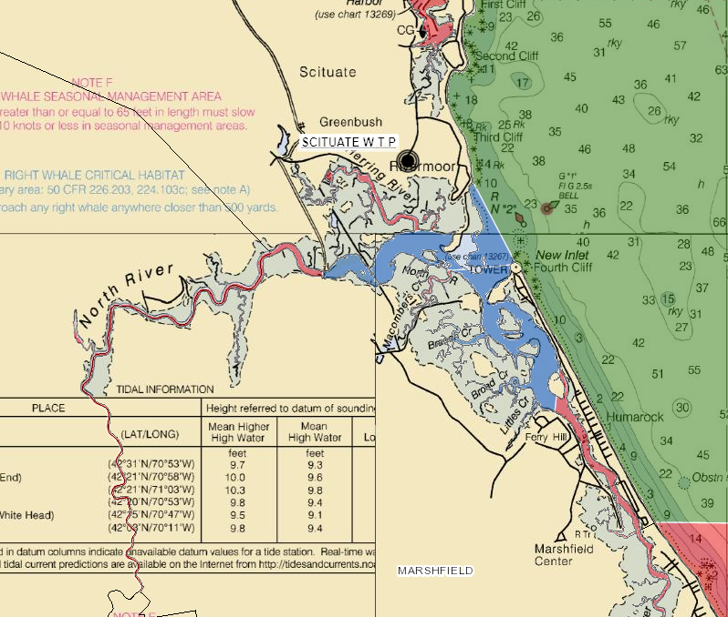
Current
Area
Classification
Conditionally Approved
MB5.1, North River East
MB6.1, South River North
Current Status - Closed
Historically
Closed
June 1 to October 31
Open
November 1 to May 31

Slide 10
Recommended
Closed
Safety
Zone
< 1000/1 Dilution
Notes:
FDA has provided a dilution analysis demonstrating that discharge from the Scituate WWTP is less than guidance stated 1000:1 dilution line within the North and South River estuary complex. Both areas/rivers are particularly shallow providing less than the optimal dilution for virus concentrated in wastewater effluent. DMF has committed to leaving MB5/MB6 closed until a dye study or alternative dilution analysis can
be conducted. DMF has requested technical assistance from the FDA to conduct a hydrographic dye study with the hope a small portion of one of these areas could be managed for shellfish harvest in the future. Certainly, we disagree as to the risk shellfish consumption presents to recreational harvesters but are committed to searching for an alternative dilution analysis methodology which nevertheless complies with the NSSP Model Ordinance criteria.

Slide 11
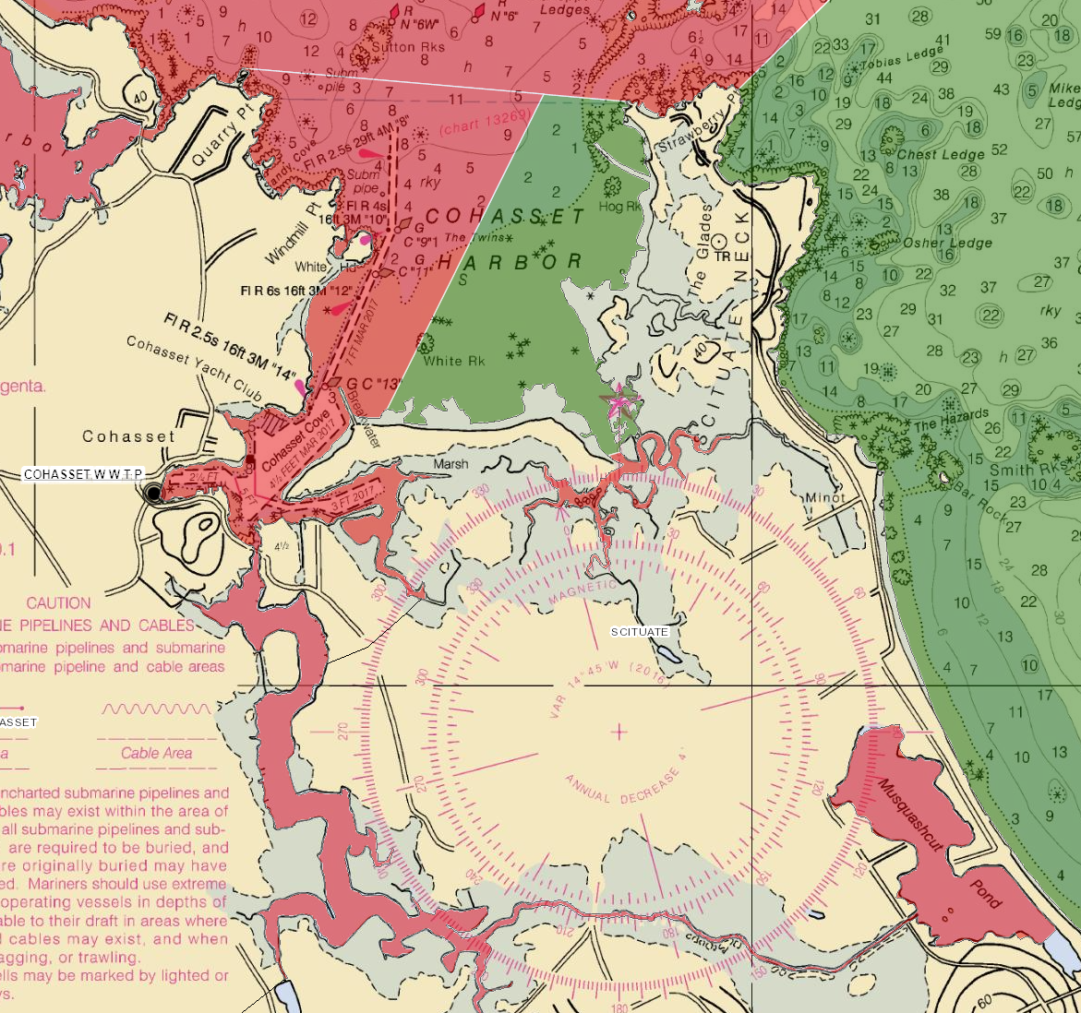
MB2.0
Current
Area
Classification
CCB48.0
MB1.0
January 2021
CCB45.0
CCB43.3
Approved (180 acres)
MB10.0, East Cohasset Harbor
Current Status – Open
Prohibited (413 acres)
MB10.1, West Cohasset Harbor
Current Status – Closed
CCB42.0
CCB41.0
CCB42.1
DMF Evaluation May 18, 2021
Slide 11

Slide 12
MB2.0
Currently –
No
Closed
Safety
Zone
or
Conditional
Area
CCB48.0
MB1.0
January 2021
CCB45.0
CCB43.3
CCB42.0
CCB41.0
CCB42.1
DMF Evaluation May 18, 2021
Slide 12
Notes:
Cohasset WWTP is much smaller than Scituate averaging around 300,000 gpd. Currently there is no CSZ or Conditional Area. DMF is collecting data from the Cohasset Plant, reviewing plant discharge monitoring reports (DMR’s) and consulting with DEP. The 1000/1 CSZ will likely extend beyond the breakwater at Bassing Beach and may encompass Briggs Harbor. The 100,000/1 conditional area will encompass the remaining portions of Cohasset Harbor, extending outside the harbor and may extend south of Strawberry Point.
A conditionally approved classification will mean the area would close due to upsets at the WWTP eg raw sewage discharge, high fecal counts, permit exceedances, etc which would impact or interrupt any harvesting – wild or aquaculture.

Slide 13
What can/is be(ing) done?
Currently collecting water samples from both plants
Analyzing influent, pre-disinfection and effluent for fecal coliform
Also analyzing samples for Male Specific Coliphage (MSC) – viral indicator
Conduct WWTP Evaluations
Meet with Plant Operators, Town officials, and DEP
DMF will use a GIS tool for volumetric calculations to set 1000/1 and 100K/1 dilution lines utilizing more accurate/current bathymetric data
DMF has submitted a request for an FDA dye study for Scituate WWTP
DMF to contract with SMAST @Umass Dartmouth
Use in-house FVCOM to model WWTP discharge from plants impacting Massachusetts shellfish growing areas

Slide 14
http://www.issc.org/nssp-guide
Section IV Guidance Documents – Chapter II. Growing Areas Starting on Page 287
.19 Classification of Shellfish Growing Waters Adjacent to Waste Water Treatment Plants

